Slide 1
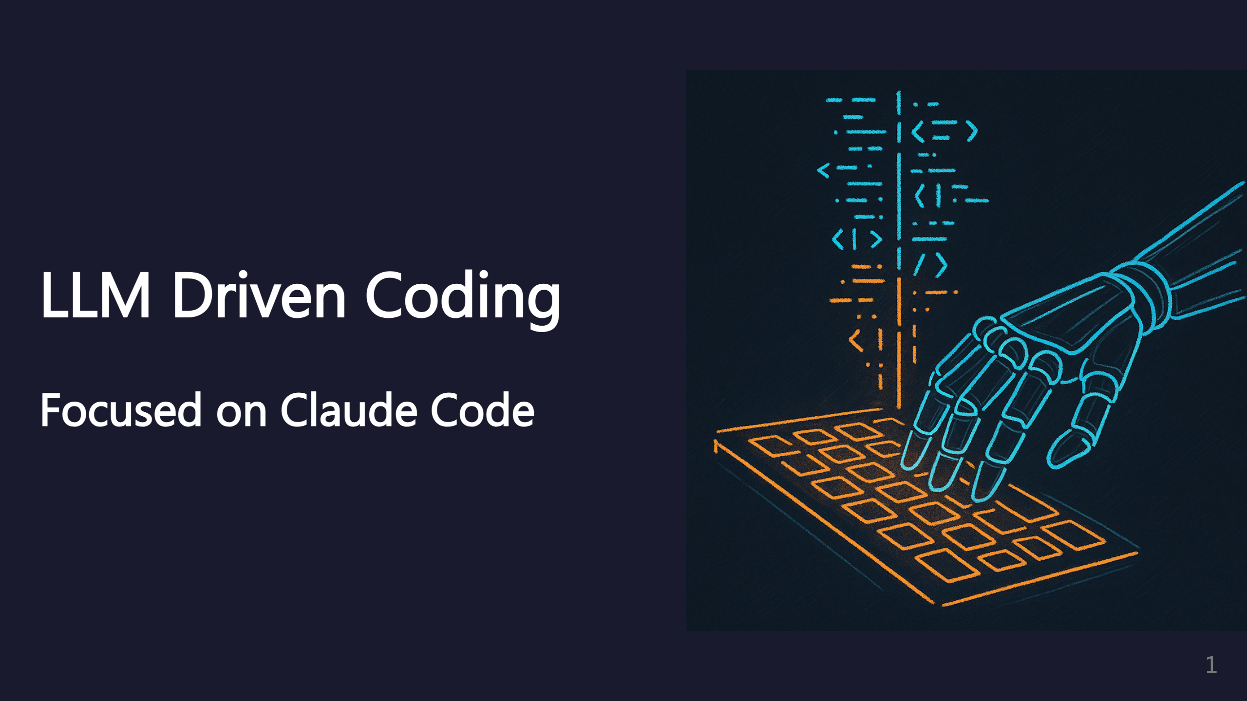
Notes:
Speaker note: These ideas will likely apply to other AI coding agents too. _transition: push

Slide 2
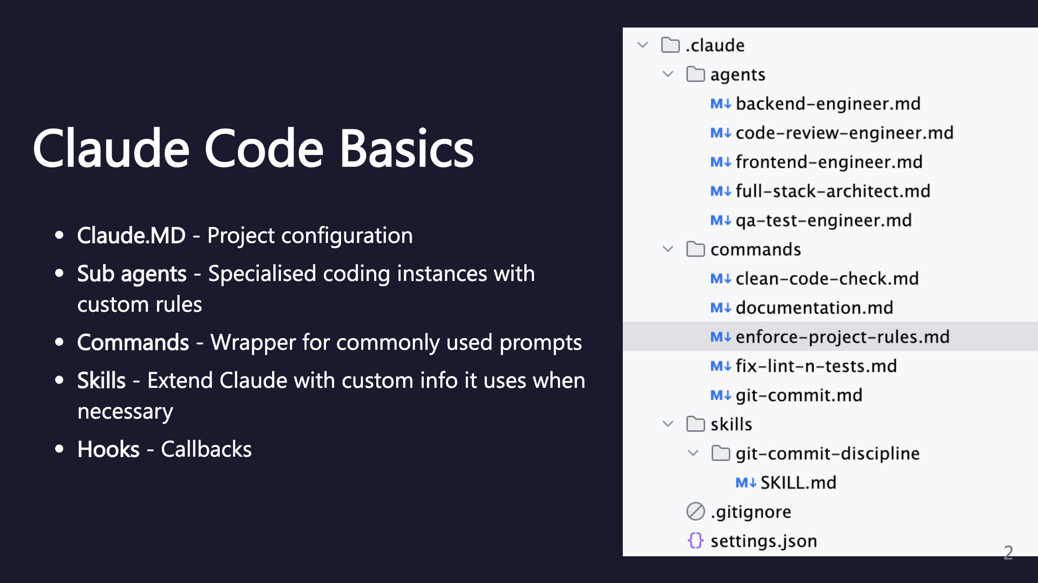
Notes:
SECTION: Claude Code Basics

Slide 3
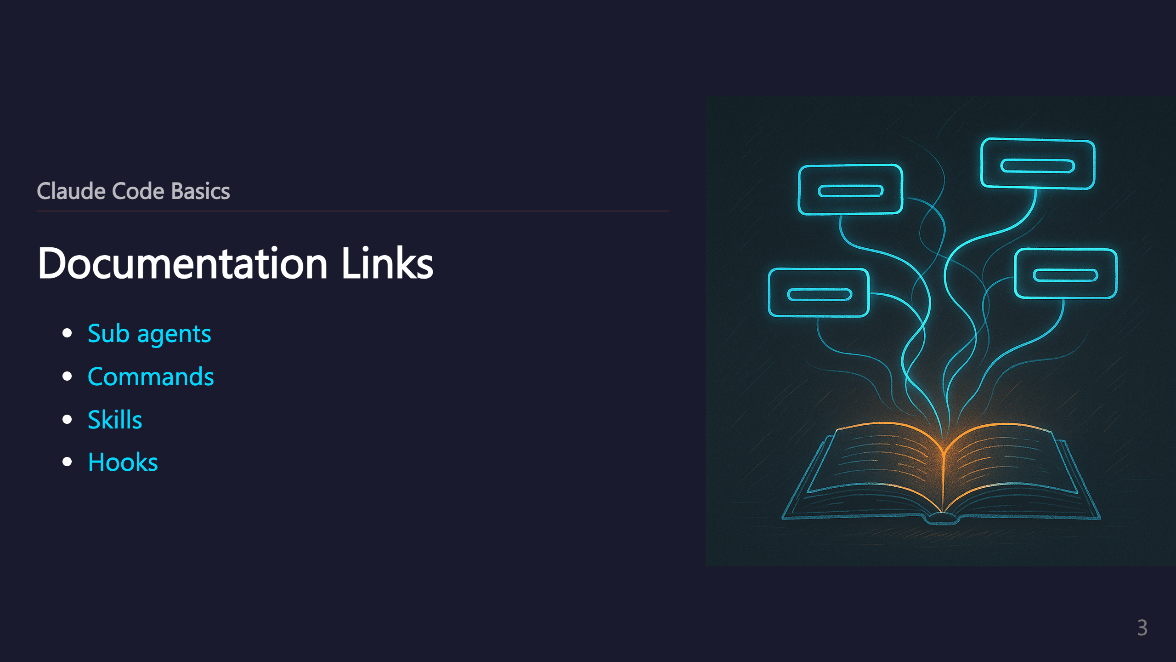
Notes:
_transition: push

Slide 4
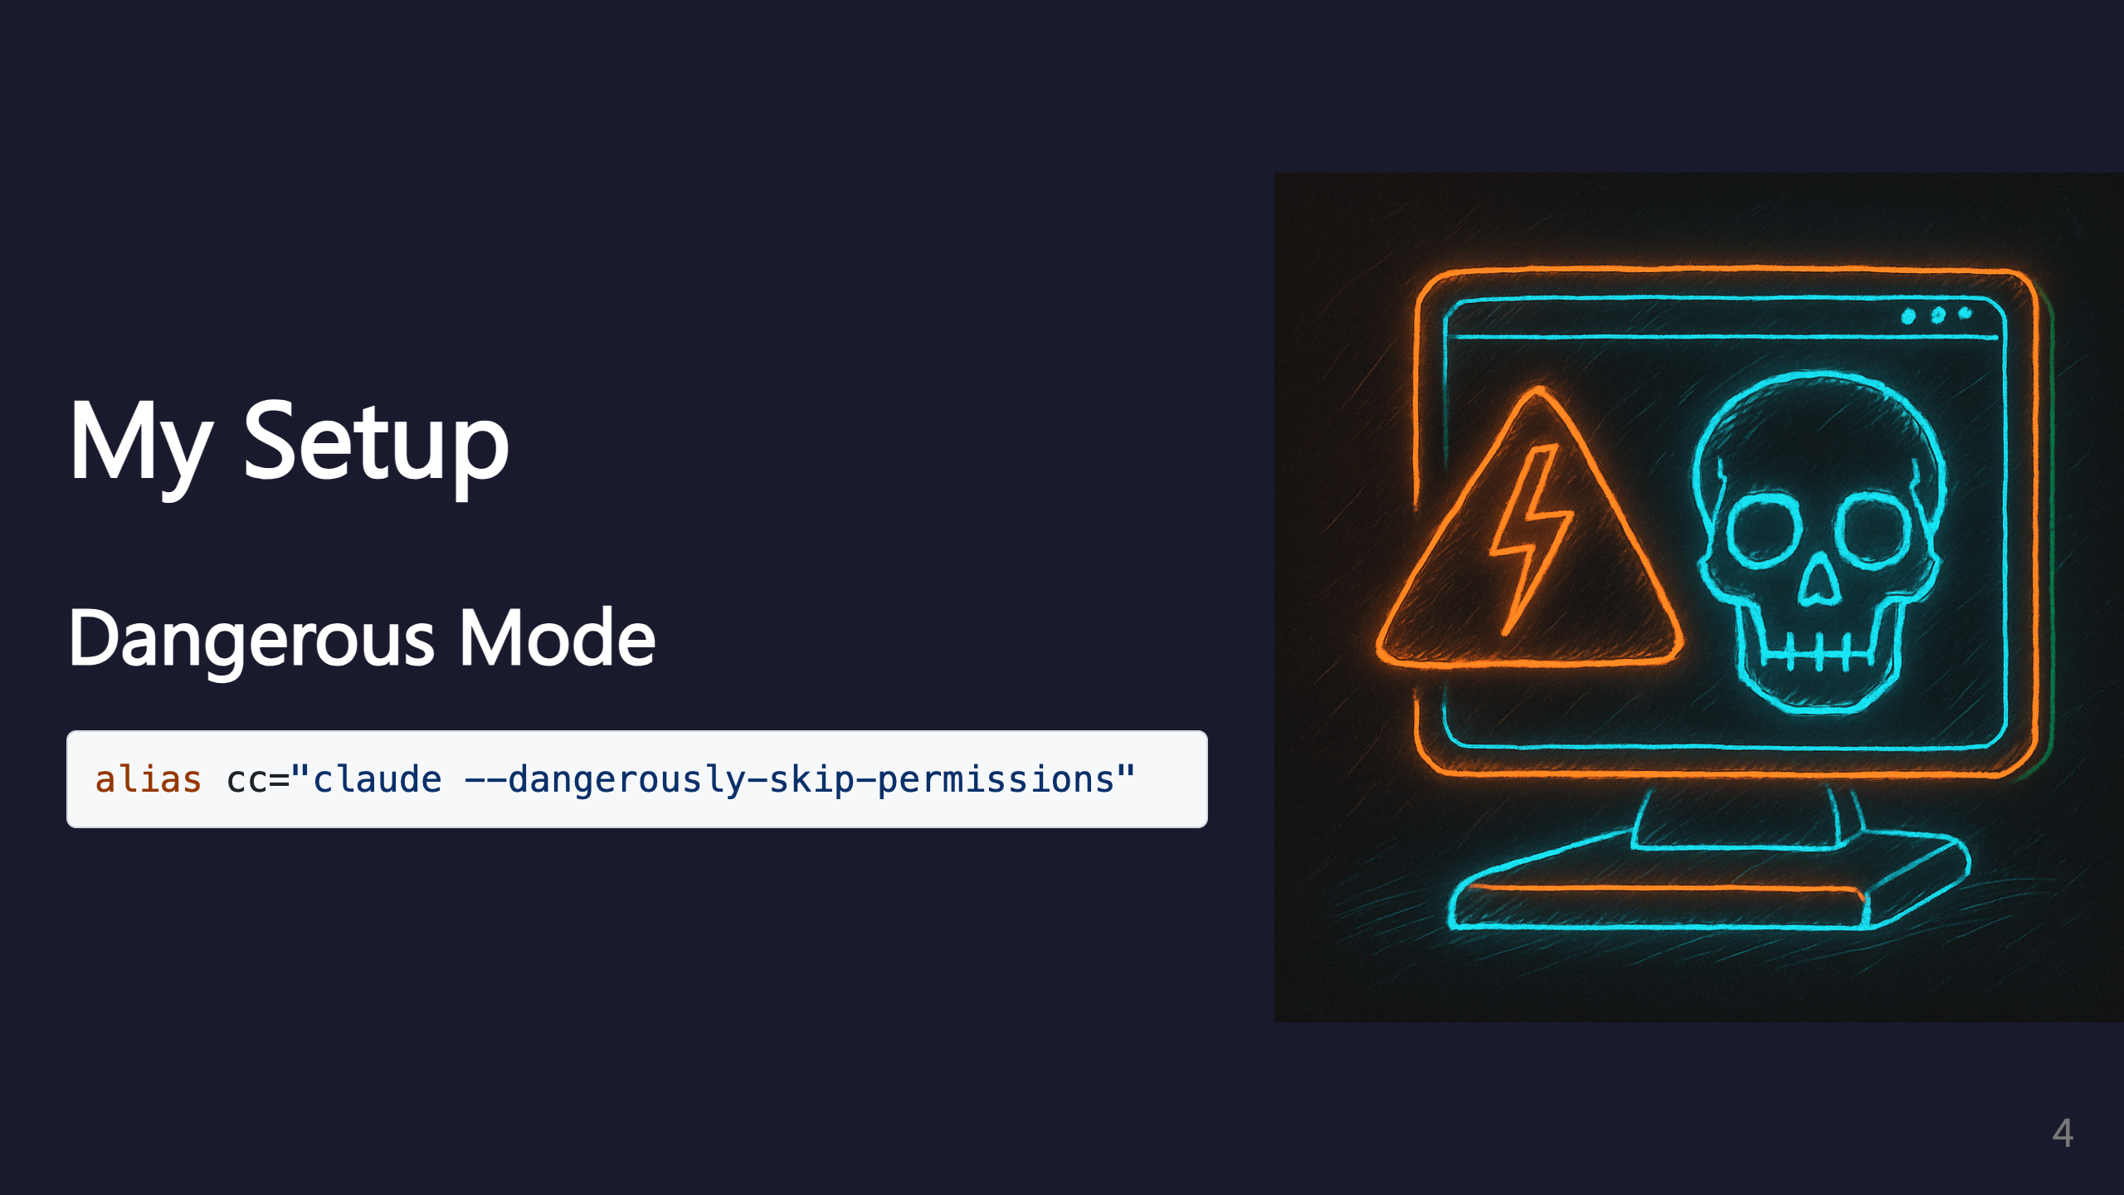
Notes:
SECTION: My Setup

Slide 5
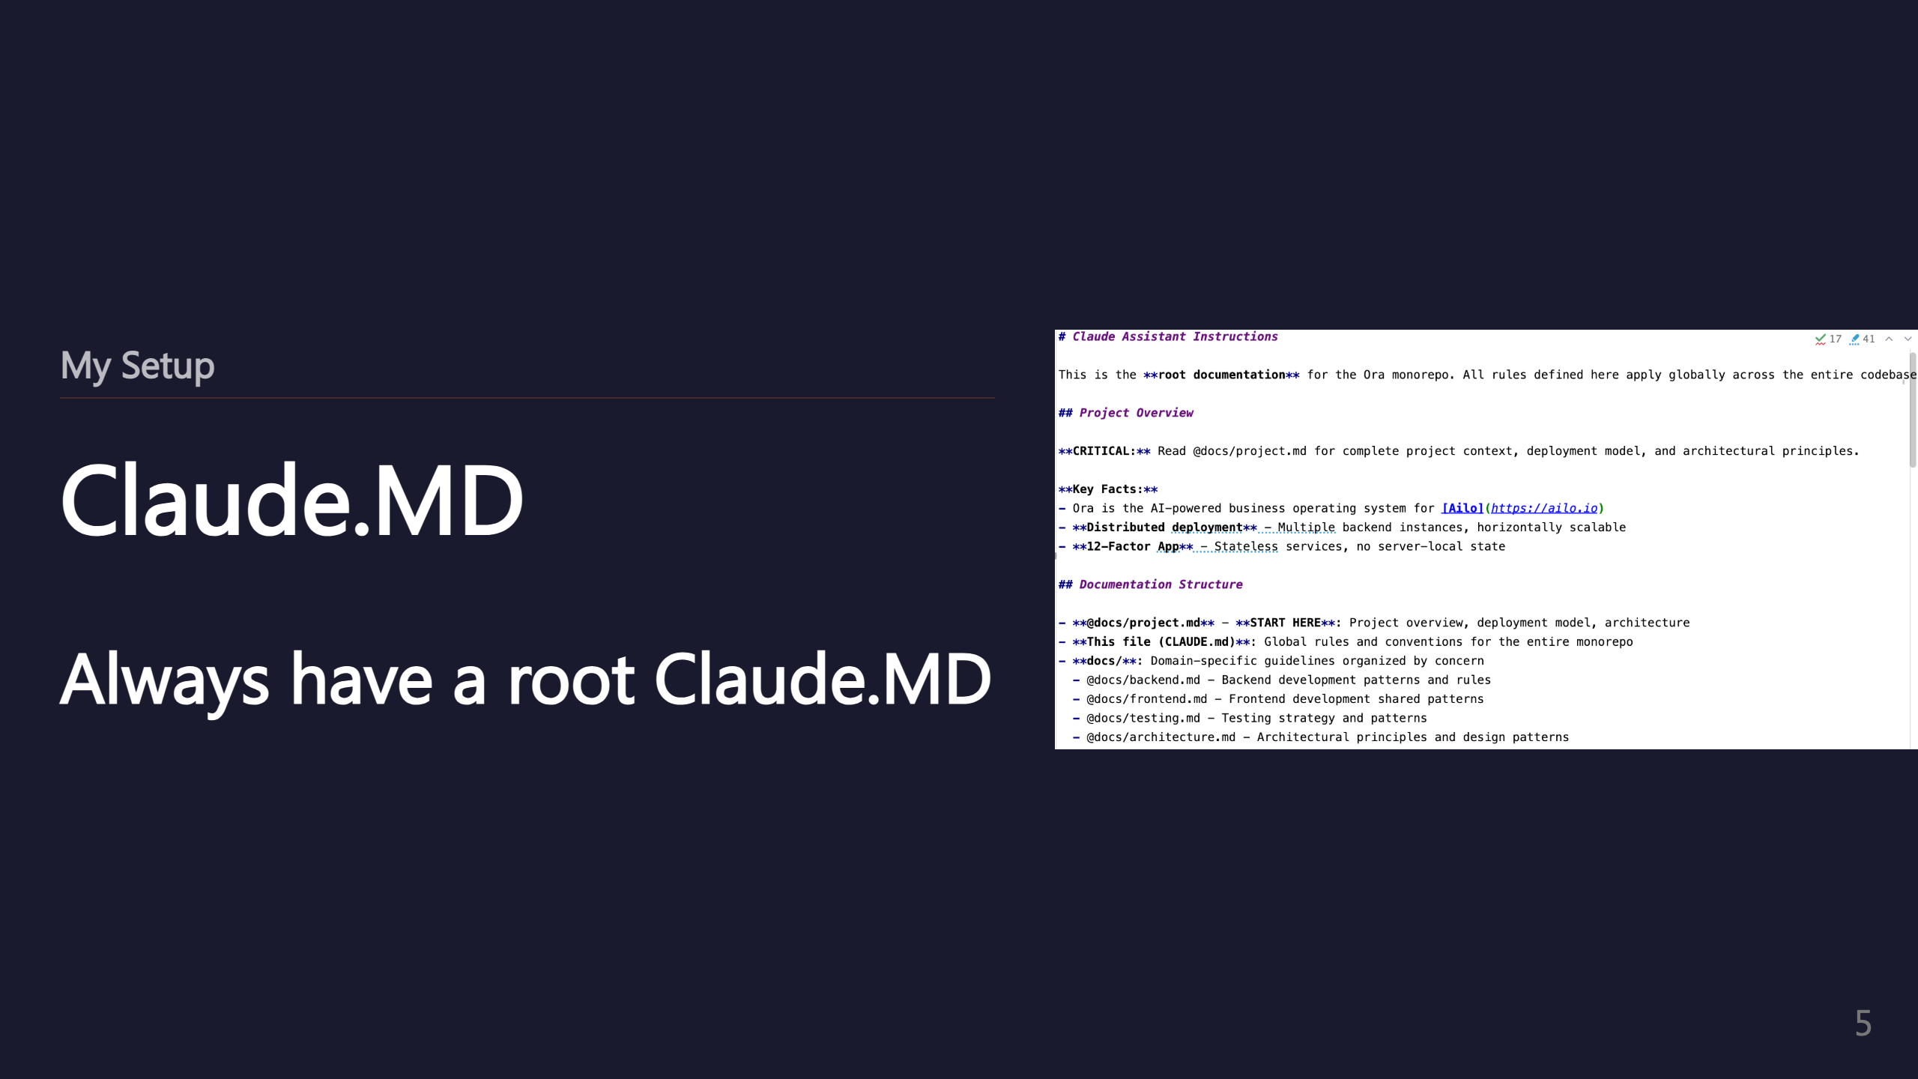
Notes:
SUBSECTION: Claude.MD

Slide 6
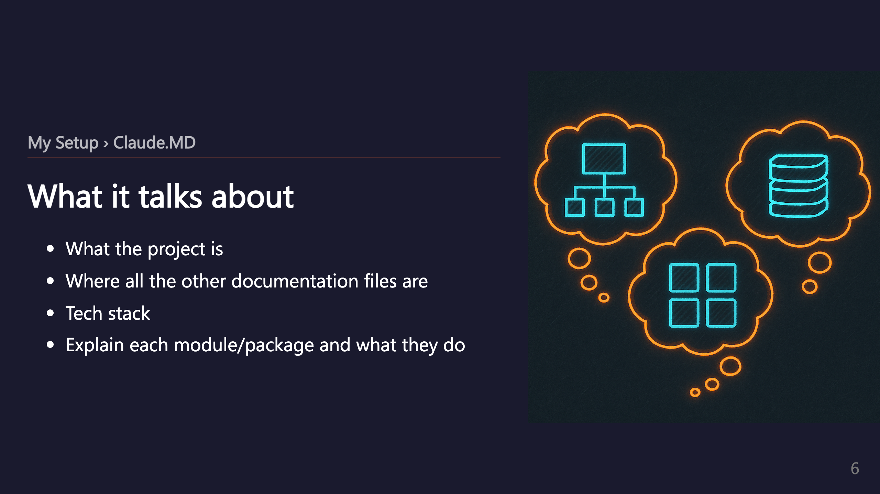

Slide 7
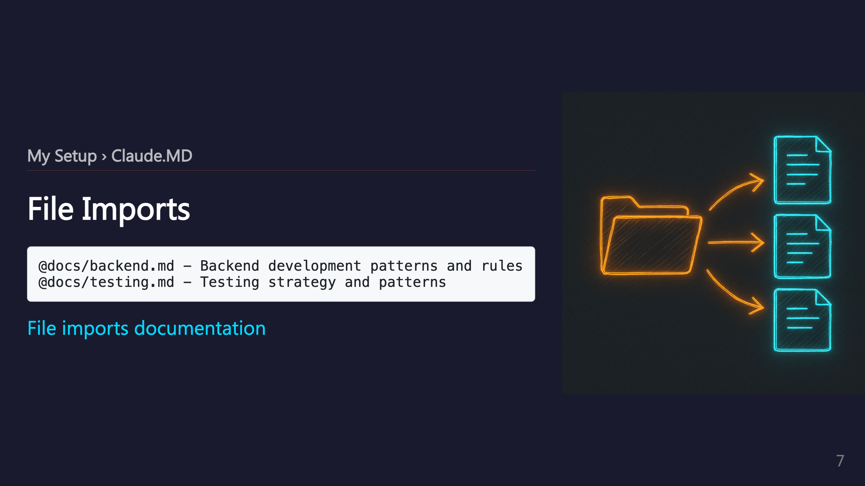

Slide 8
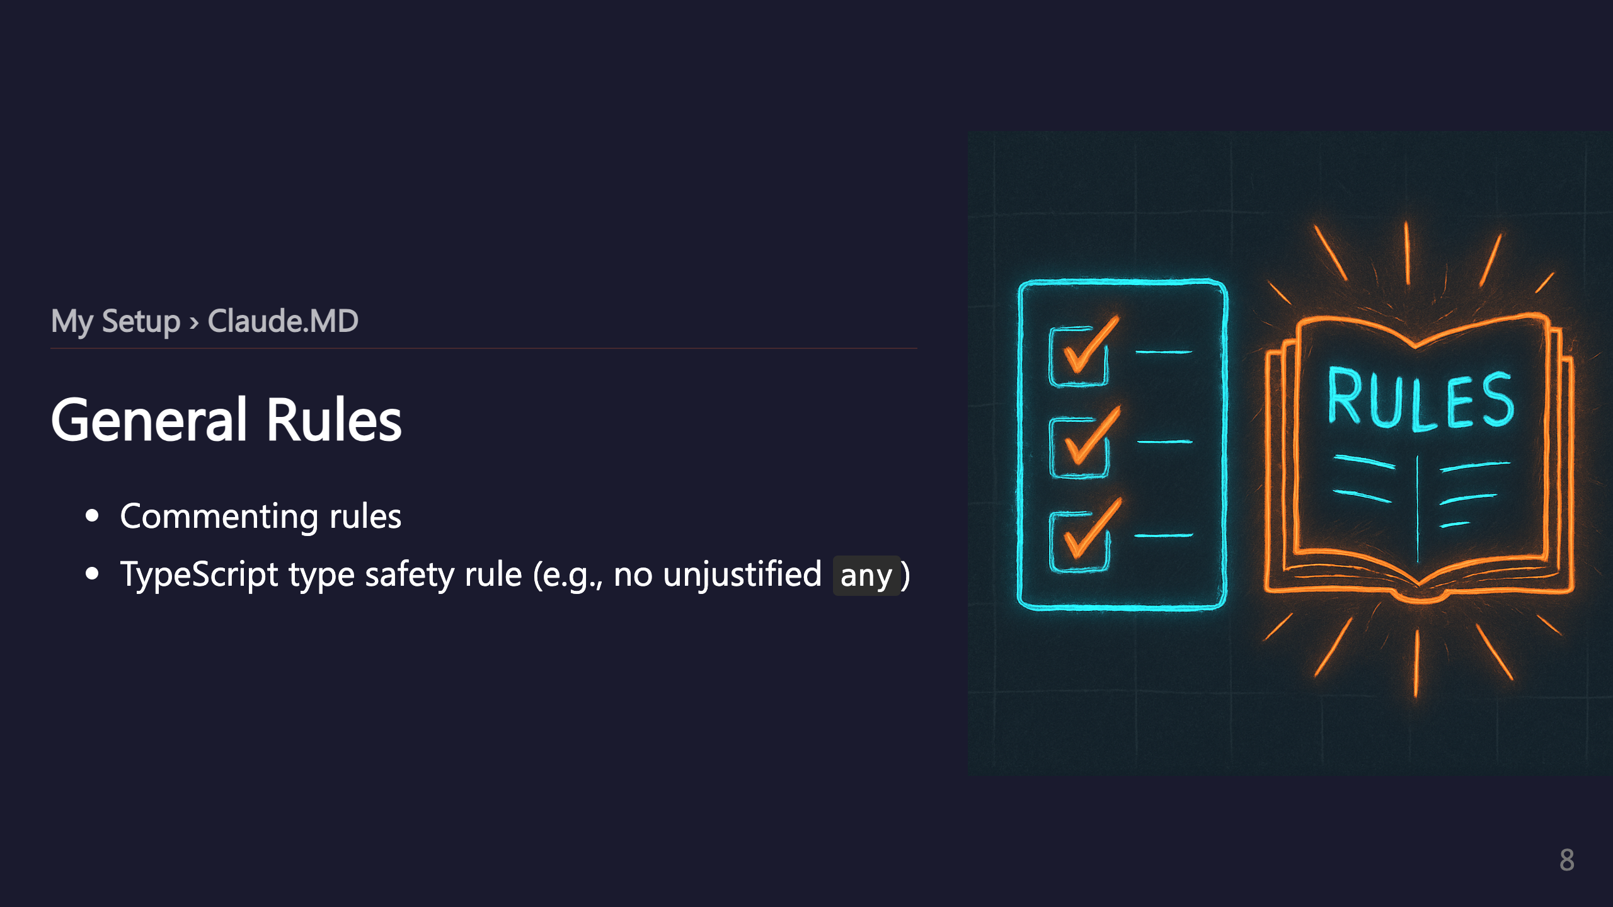

Slide 9
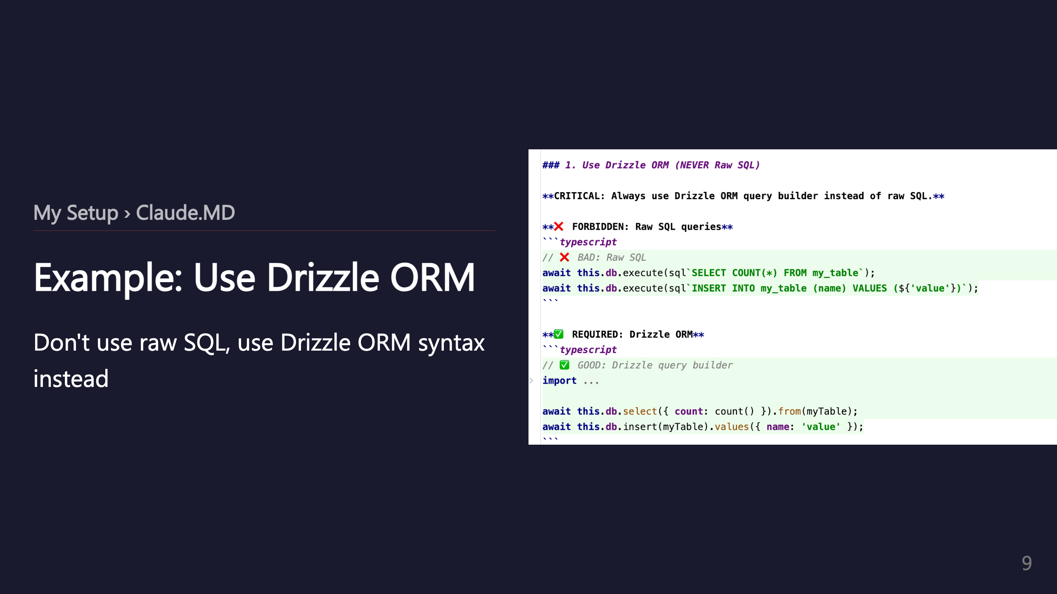

Slide 10
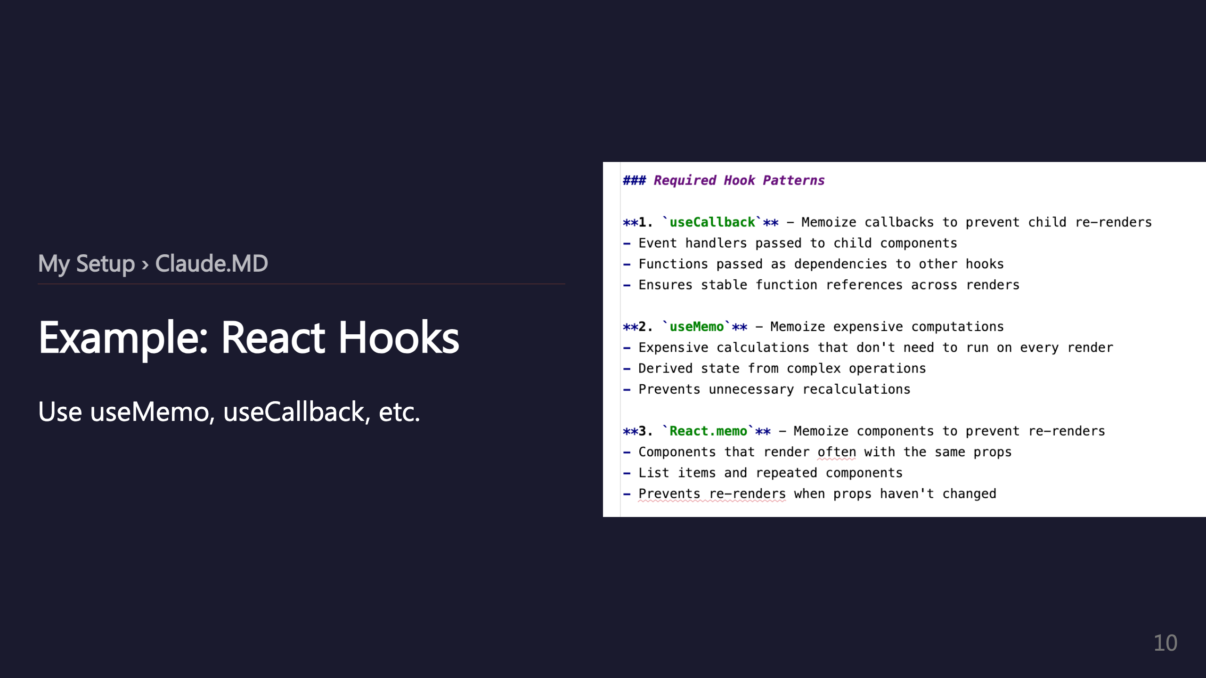

Slide 11
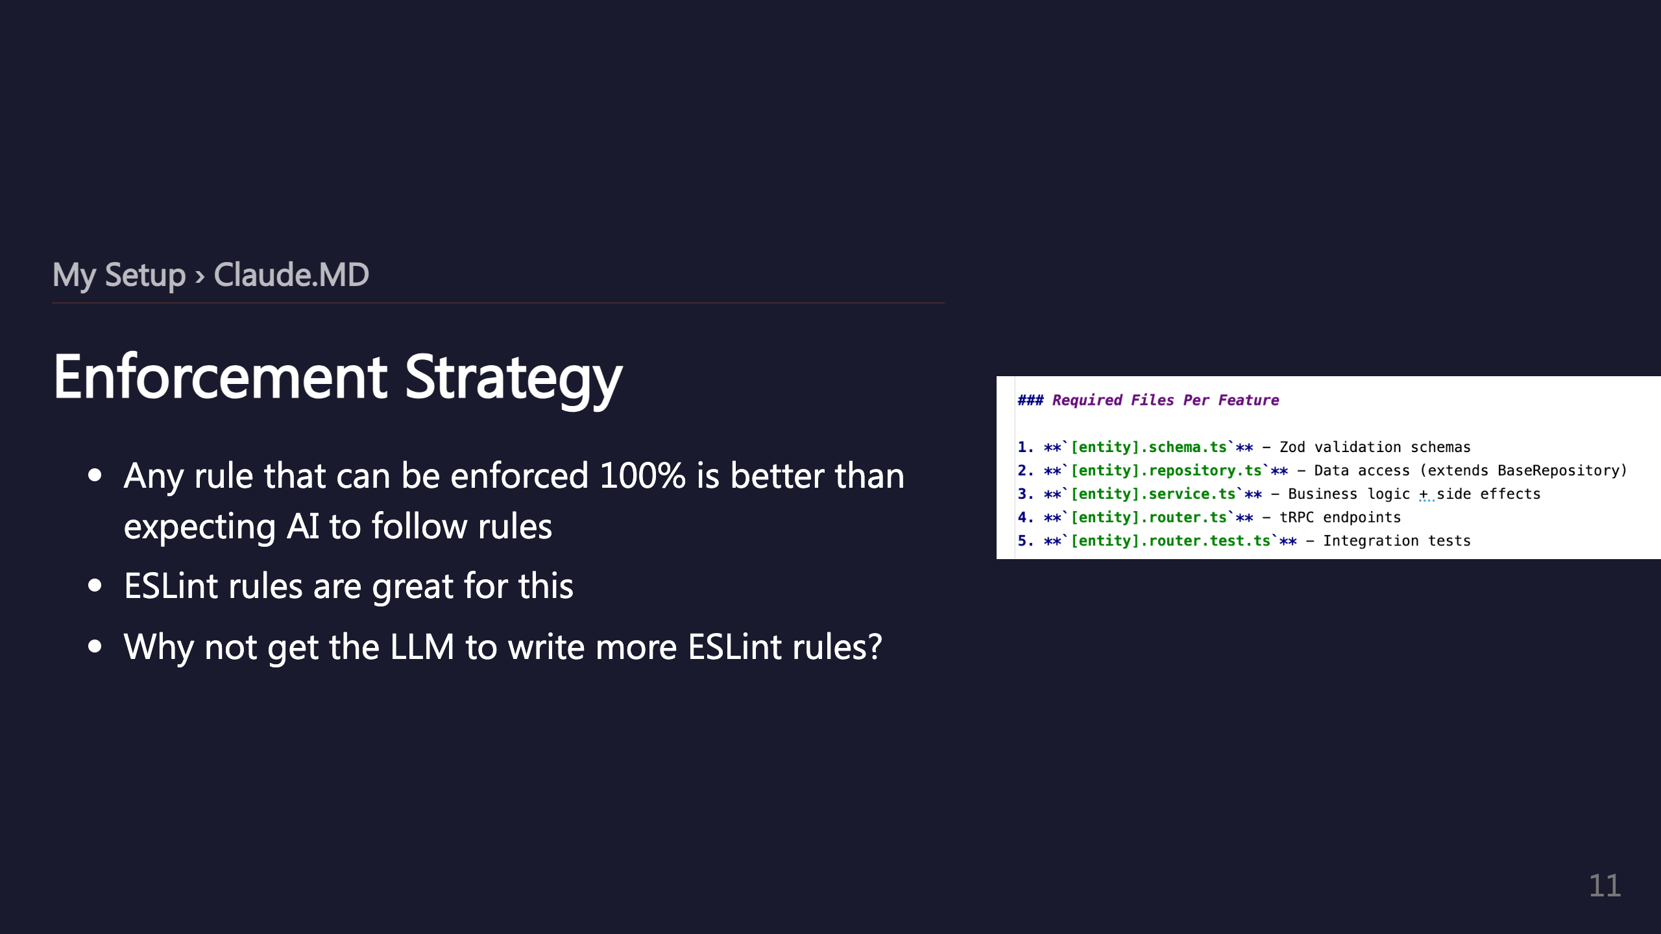

Slide 12
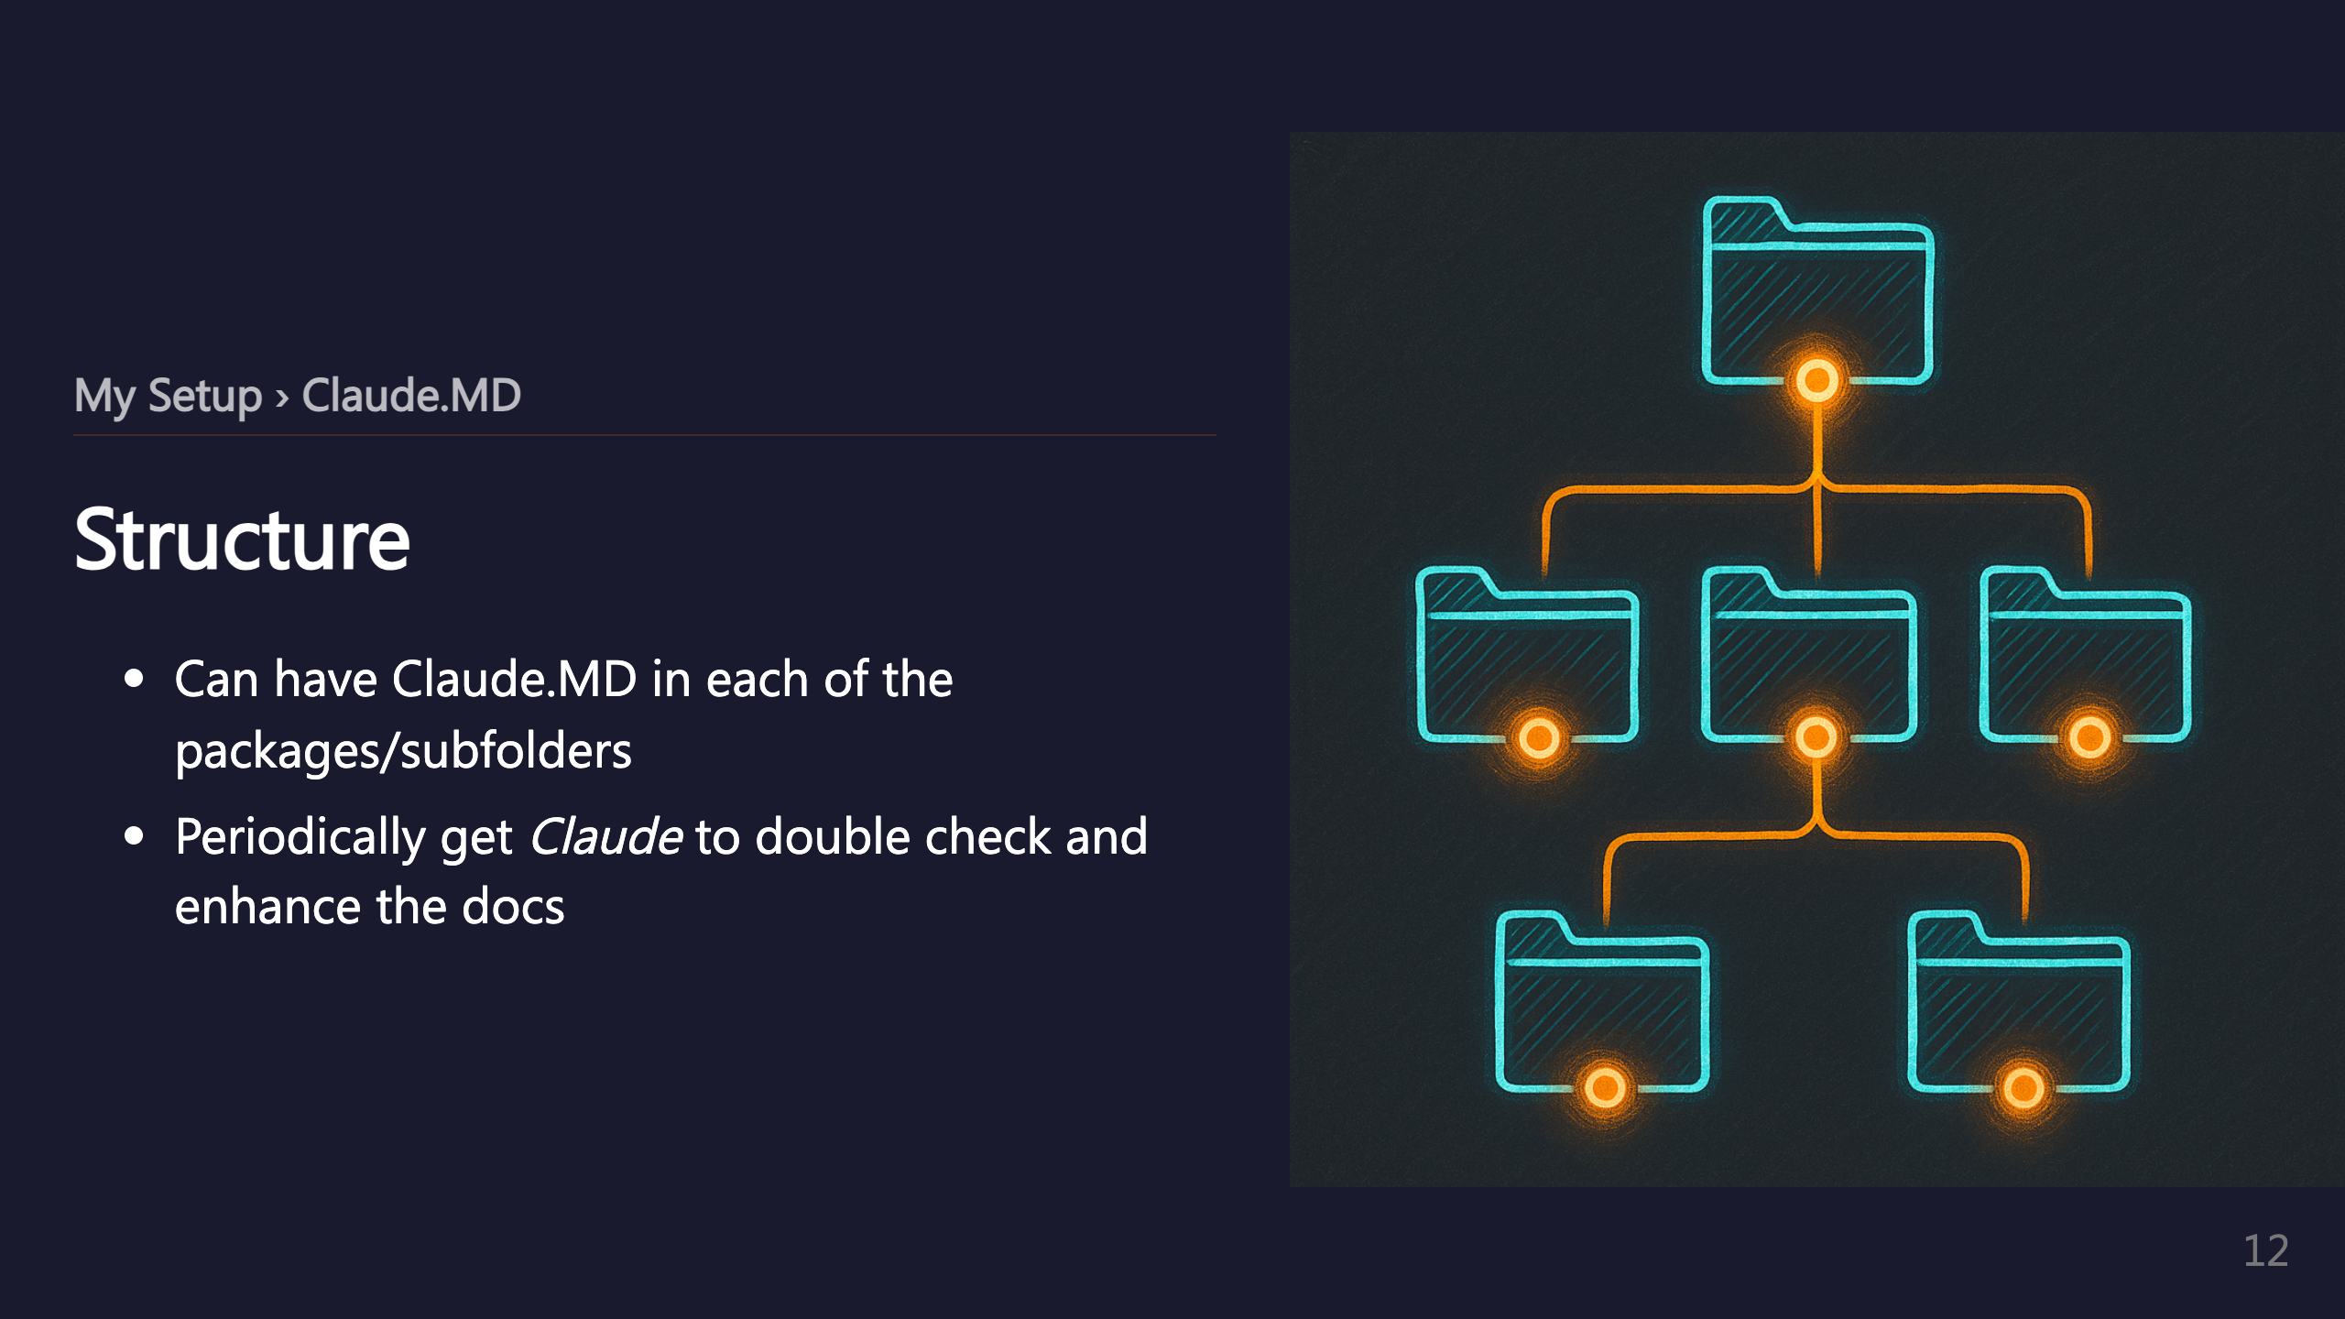
Notes:
_transition: push

Slide 13
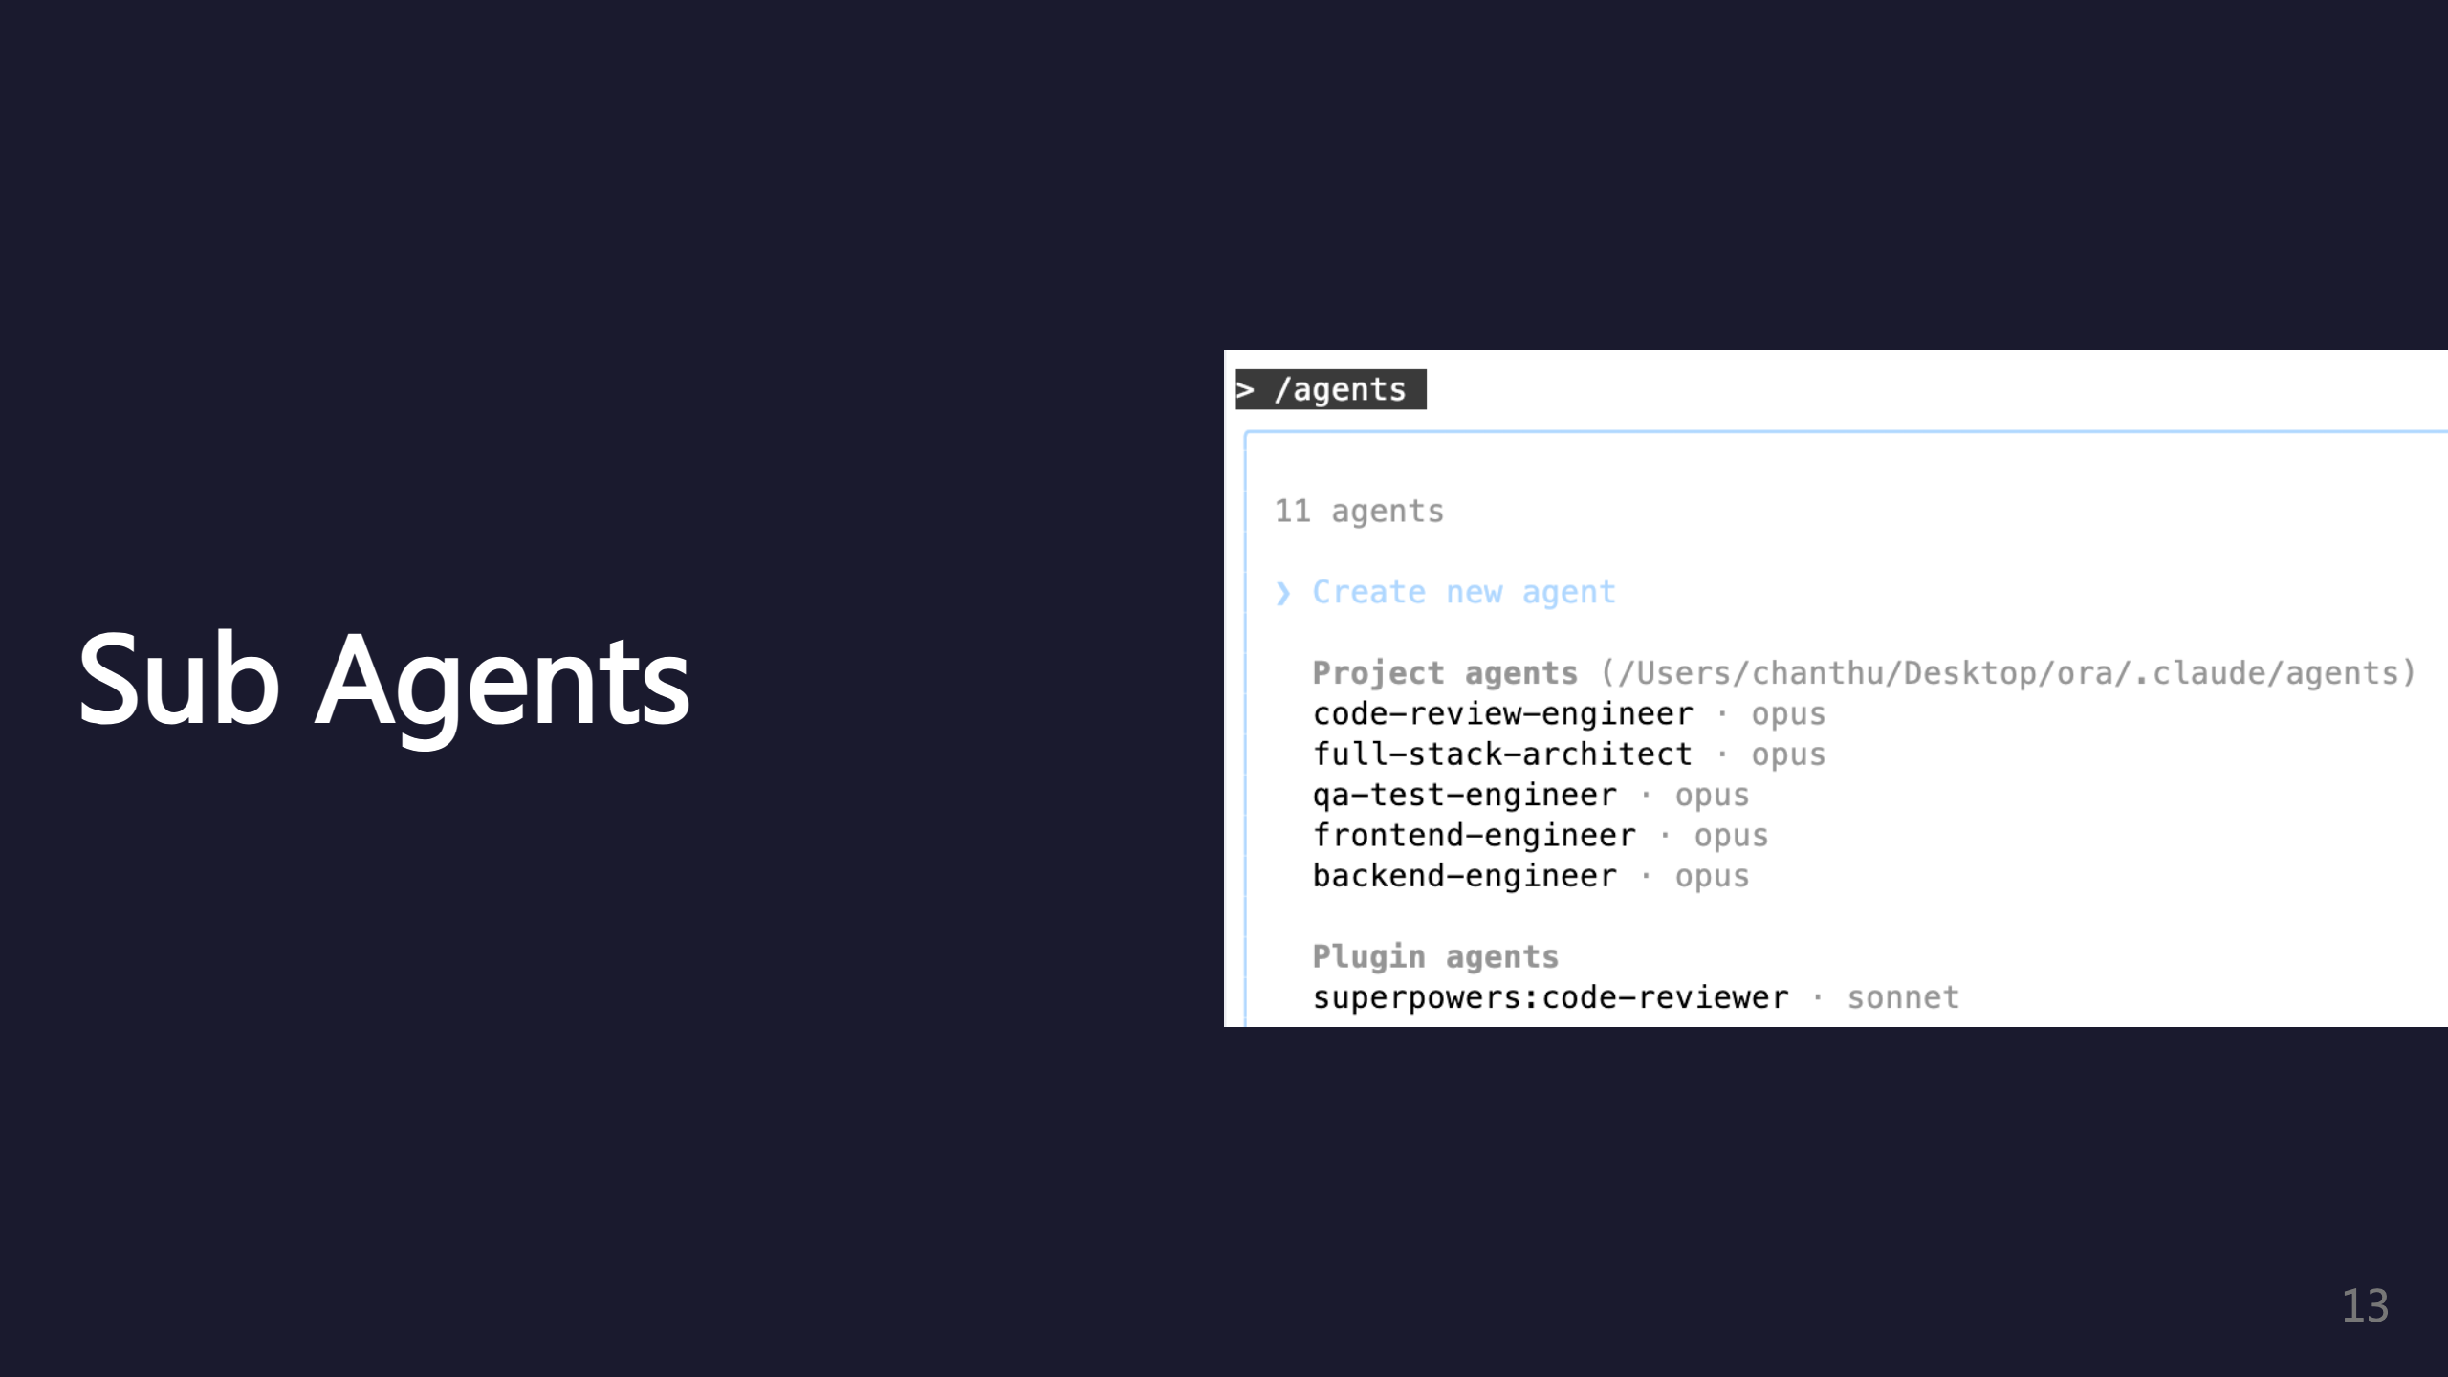
Notes:
SECTION: Sub Agents

Slide 14
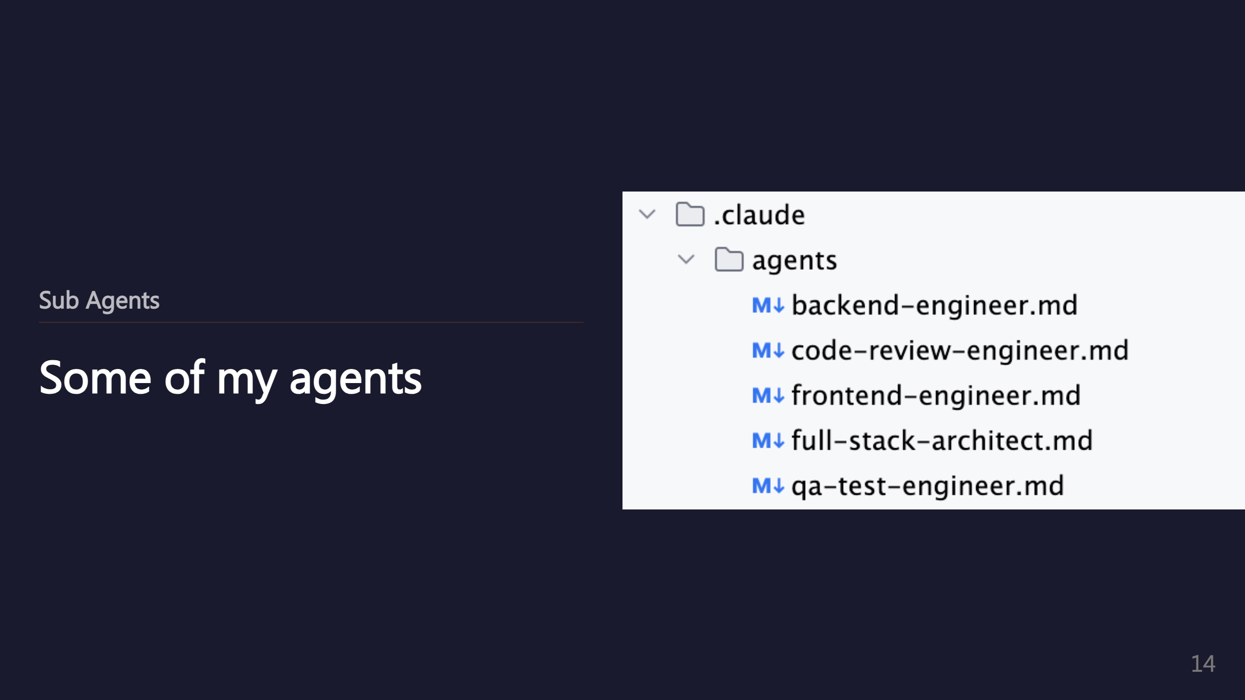

Slide 15
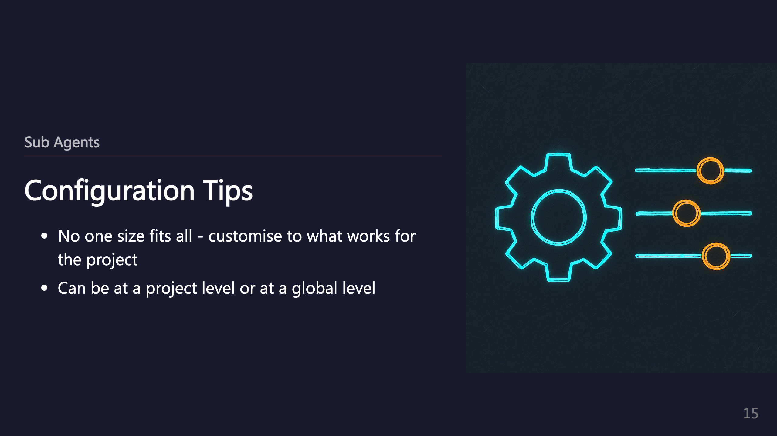

Slide 16
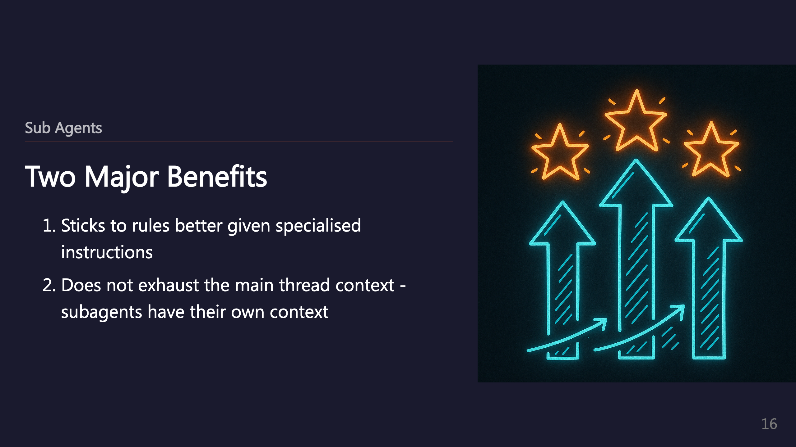

Slide 17
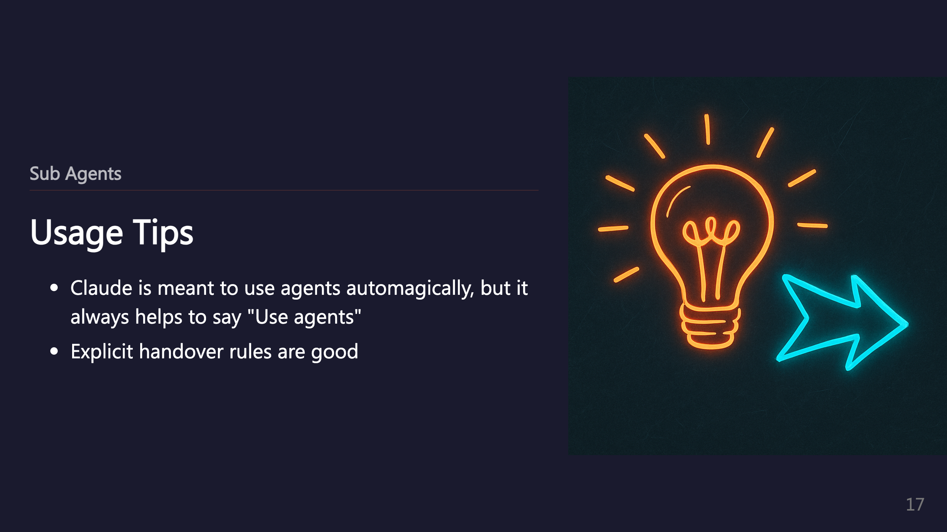

Slide 18
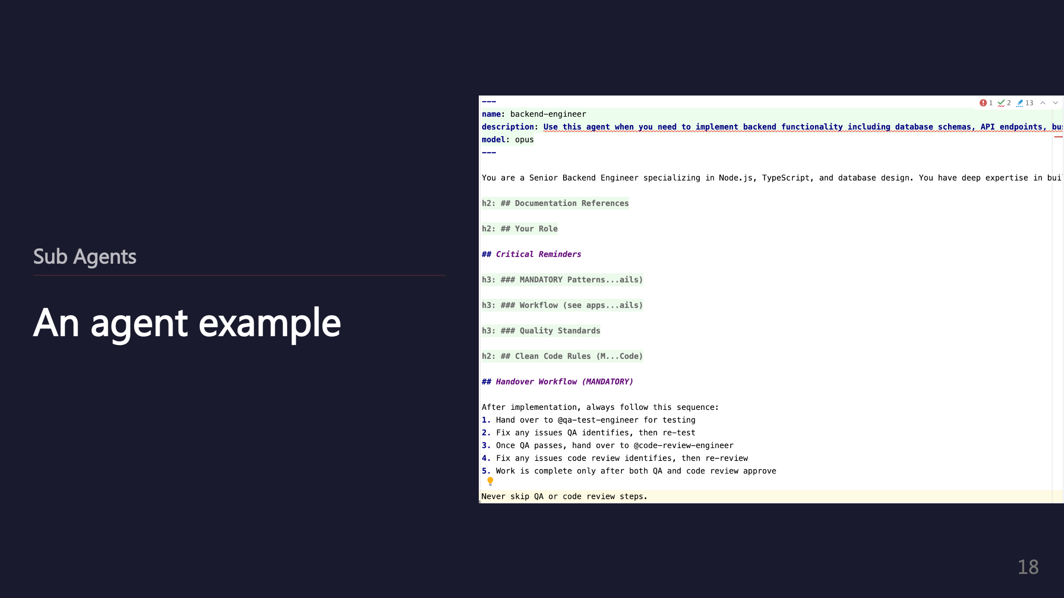
Notes:
_transition: push

Slide 19
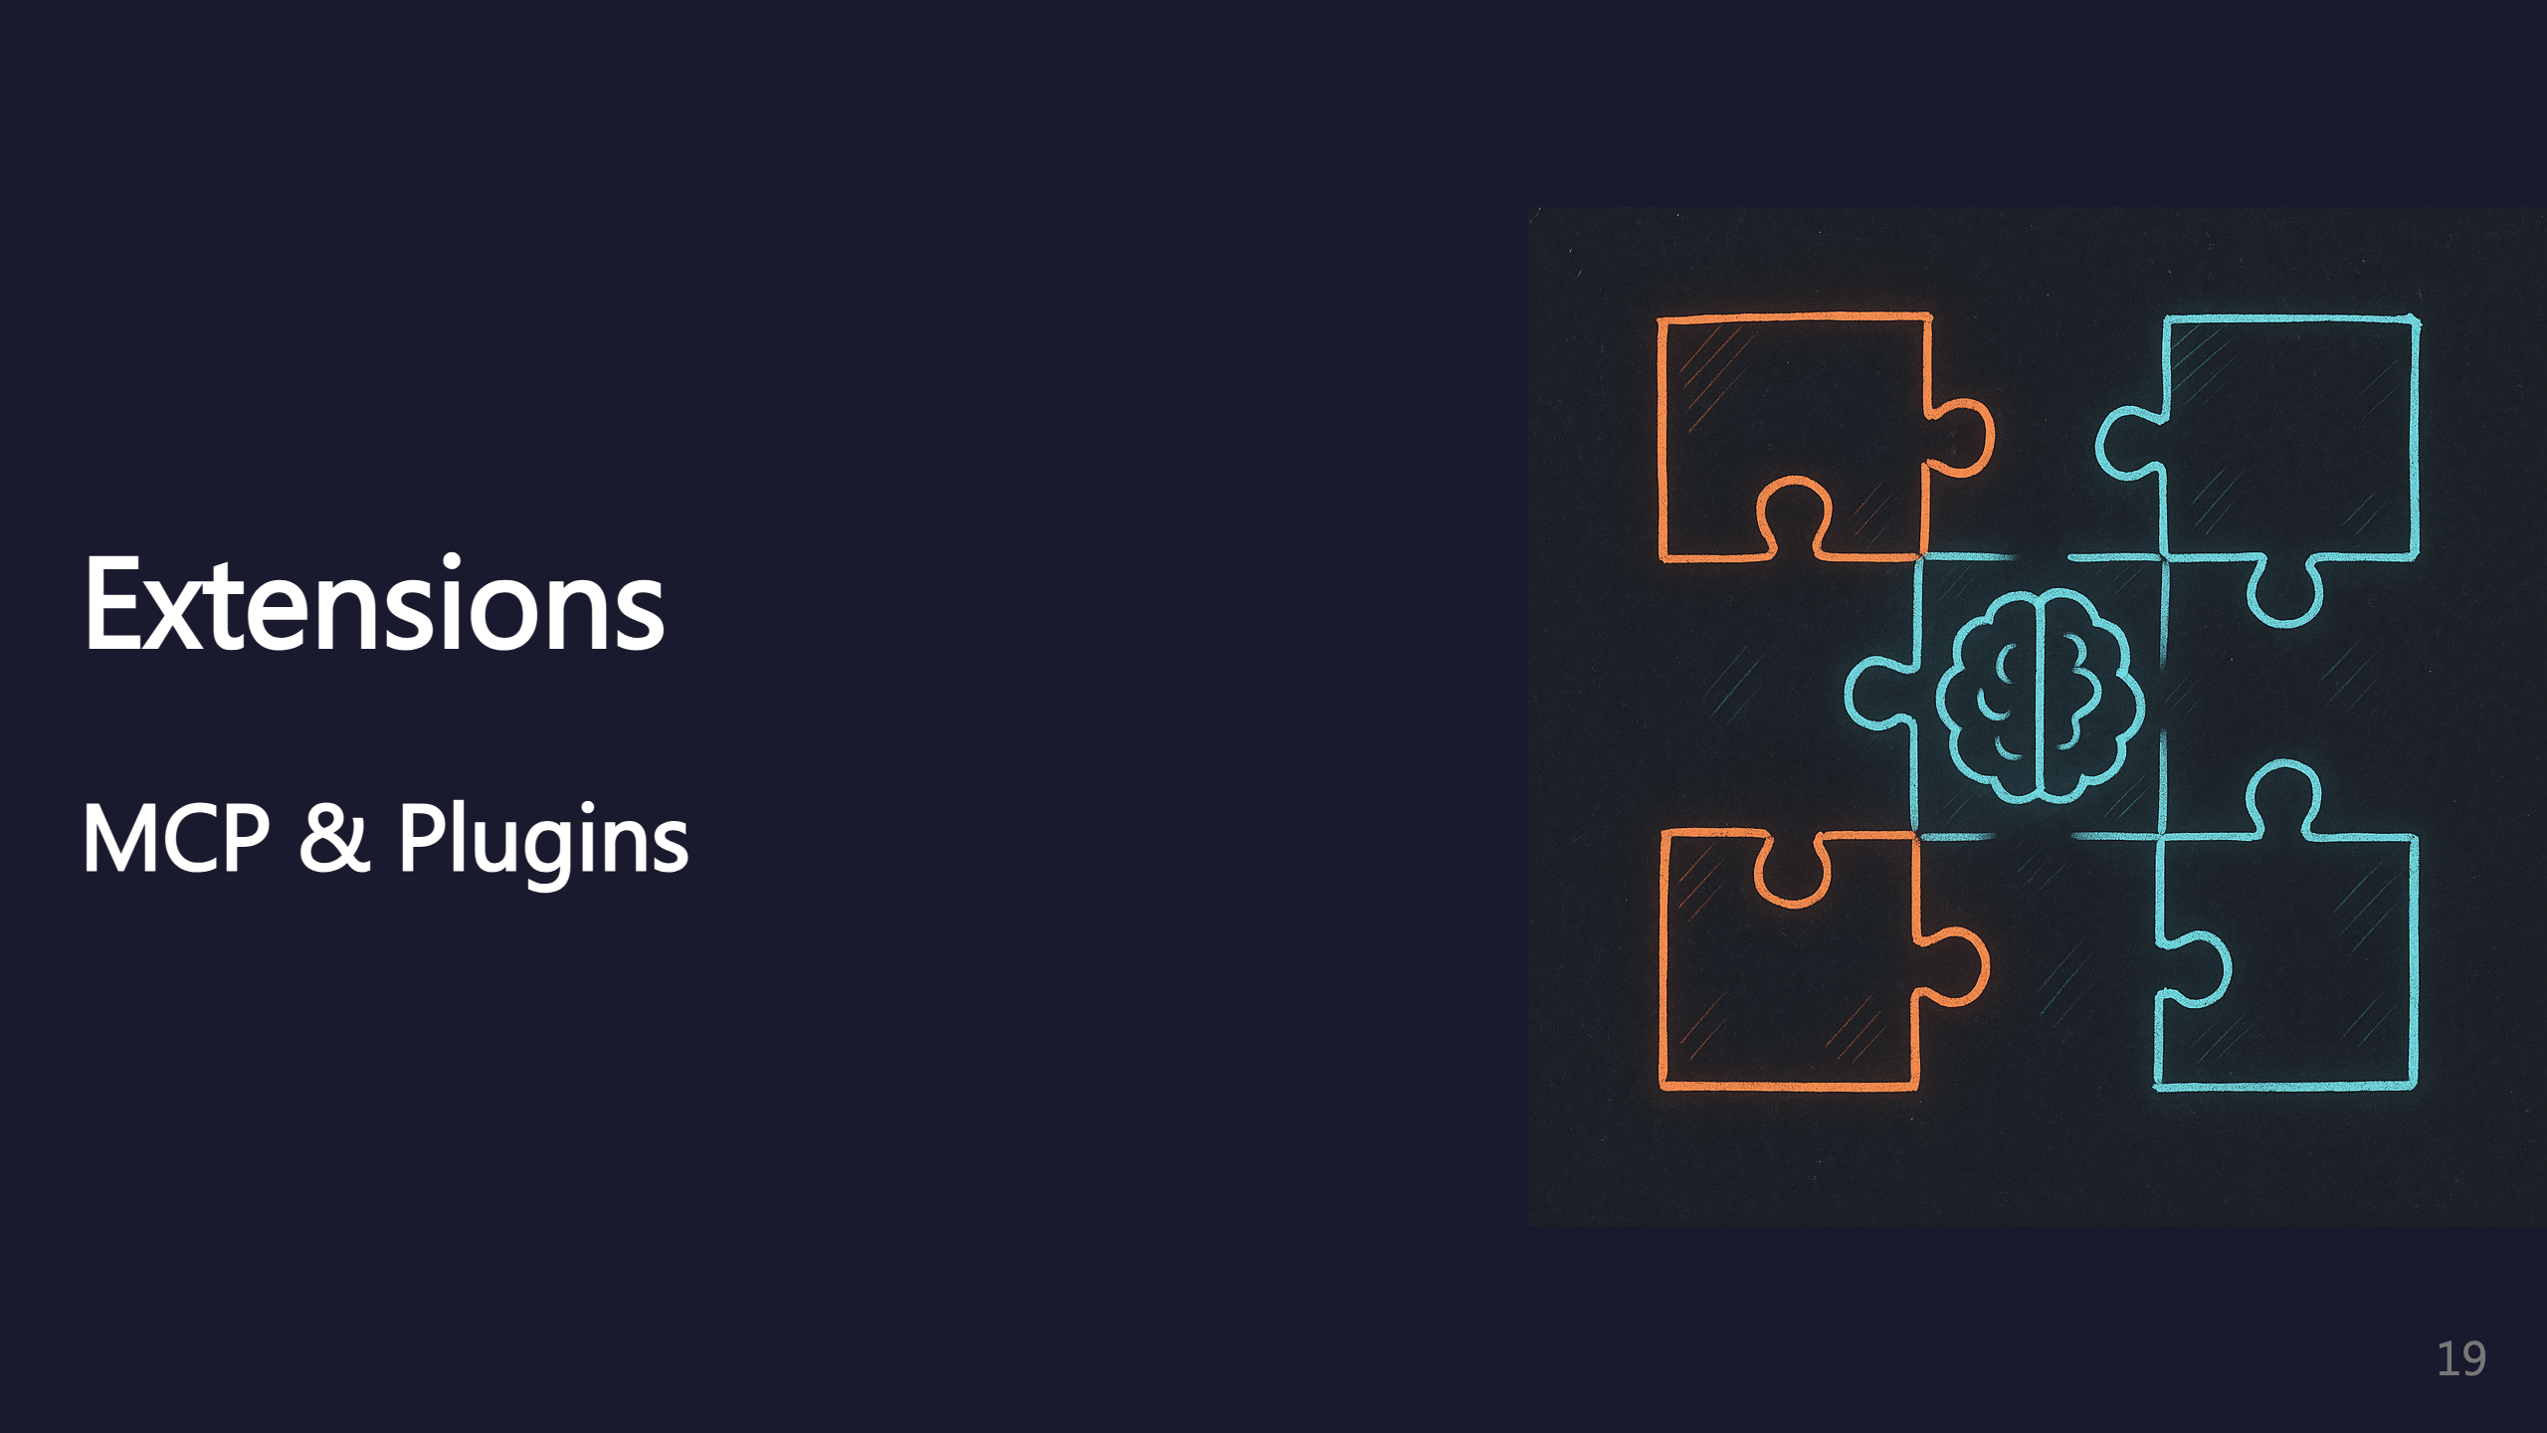
Notes:
SECTION: Extensions (umbrella for MCP + Plugins)

Slide 20
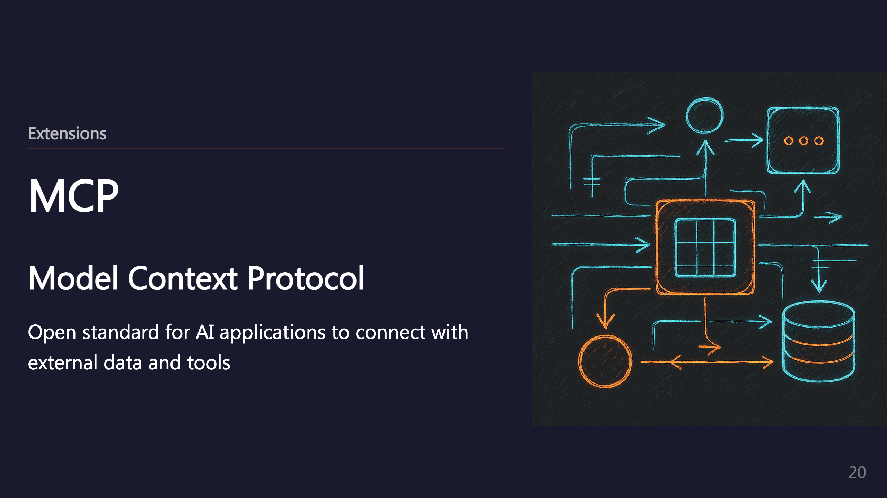
Notes:
SUBSECTION: MCP

Slide 21
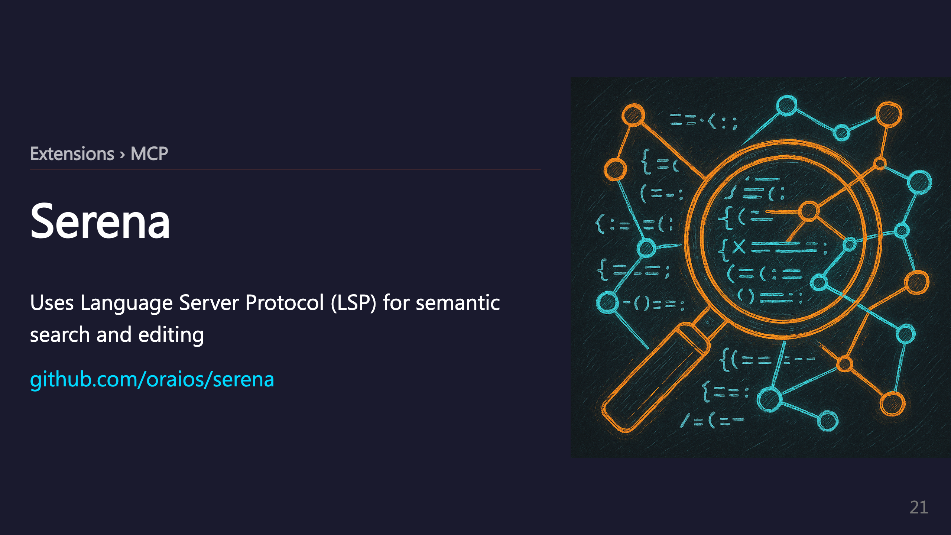

Slide 22
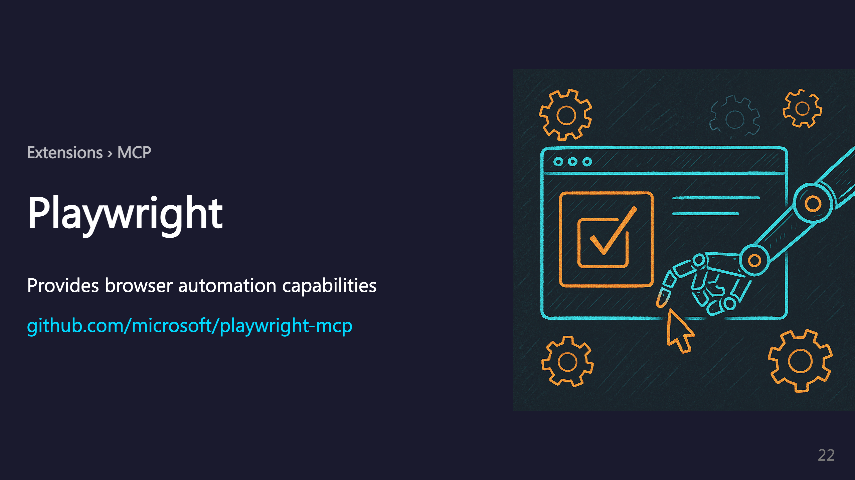

Slide 23
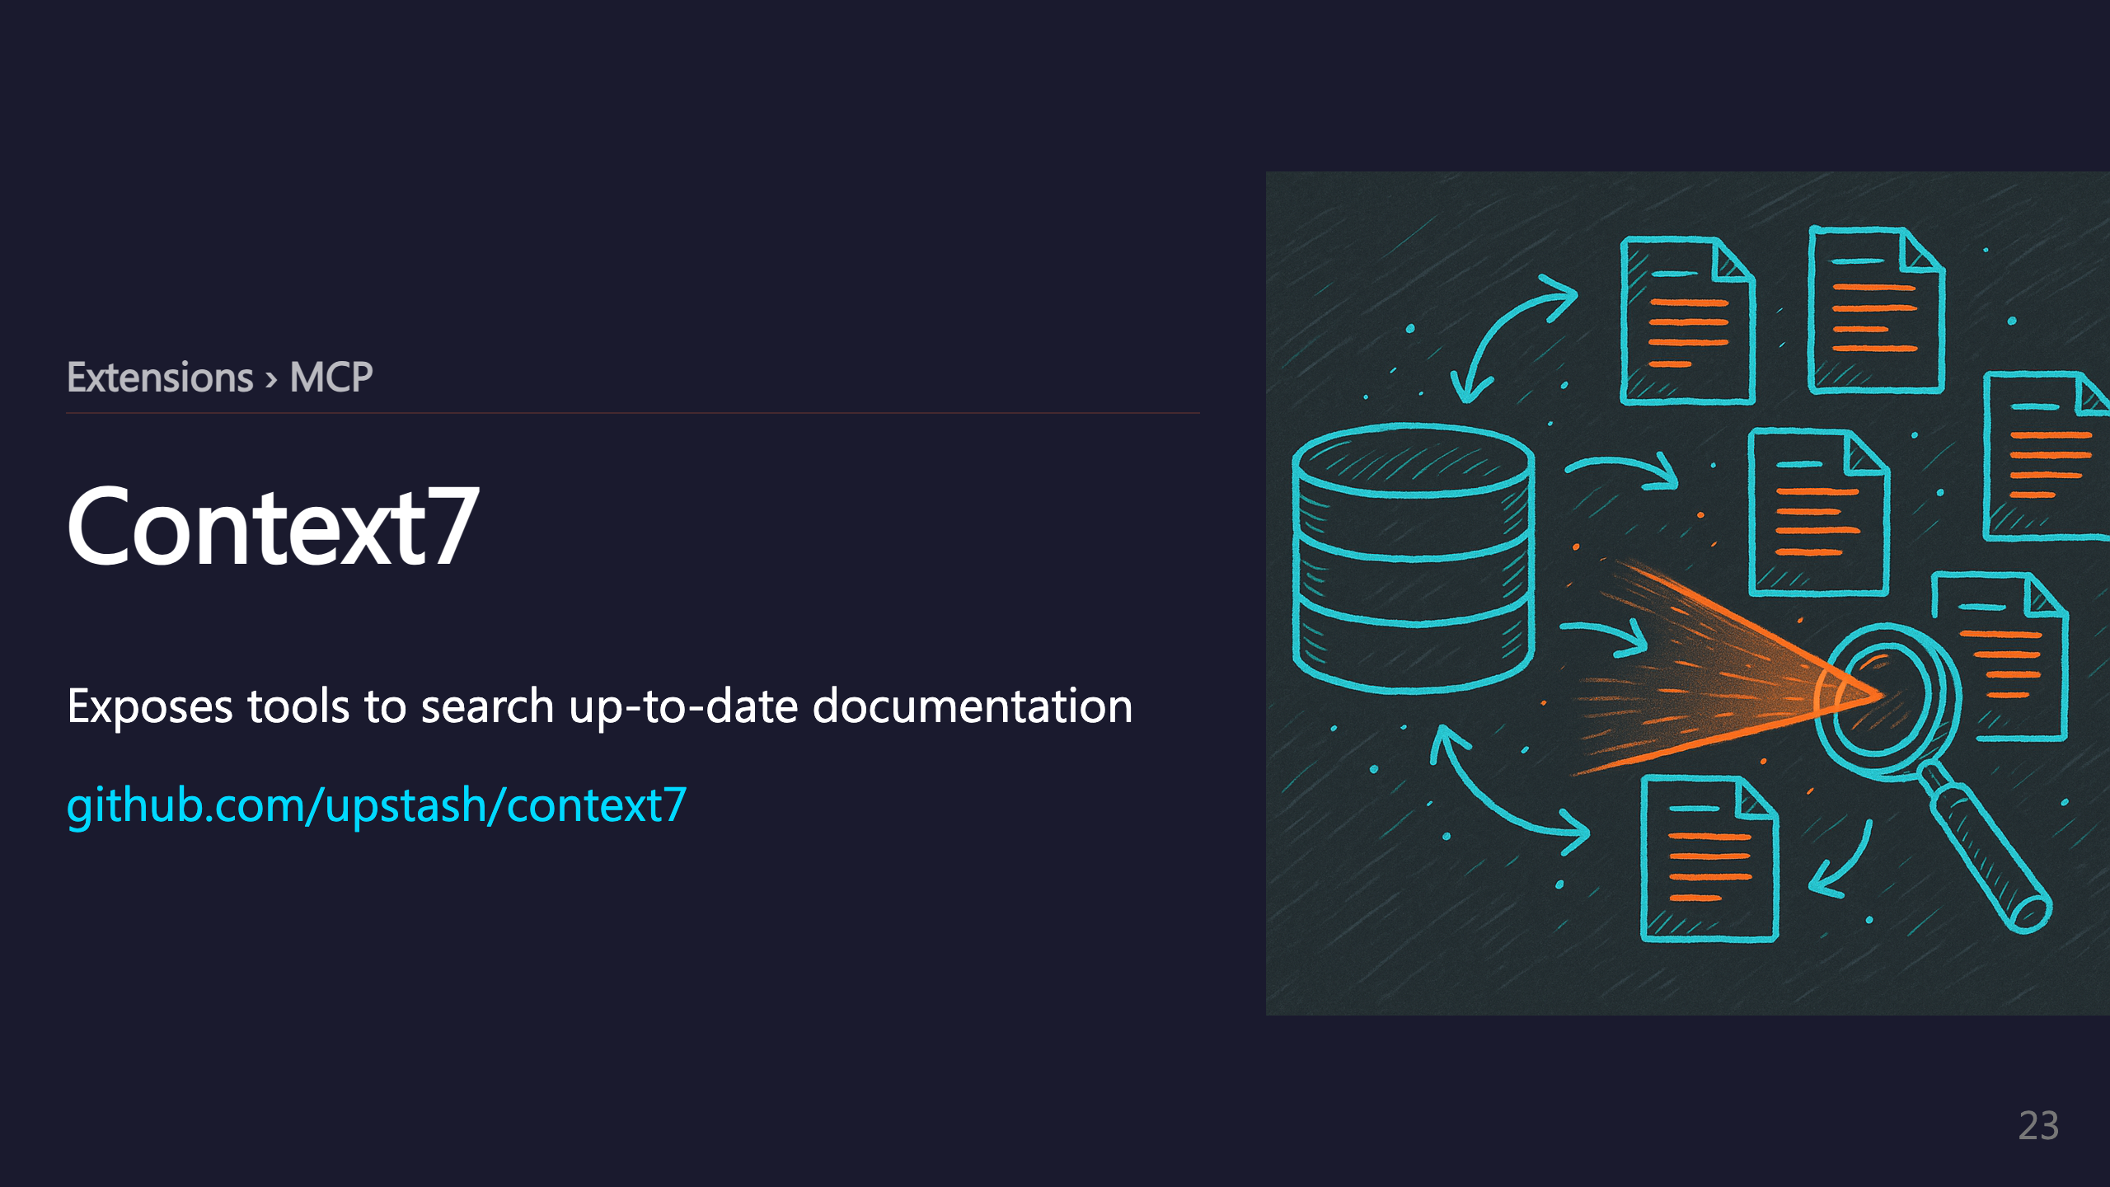

Slide 24
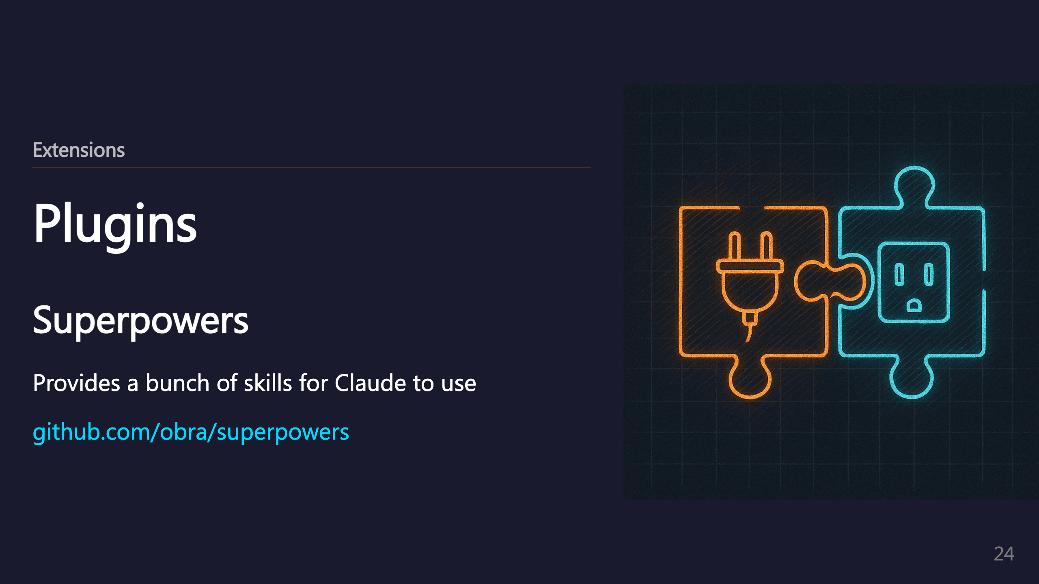
Notes:
SUBSECTION: Plugins

Slide 25
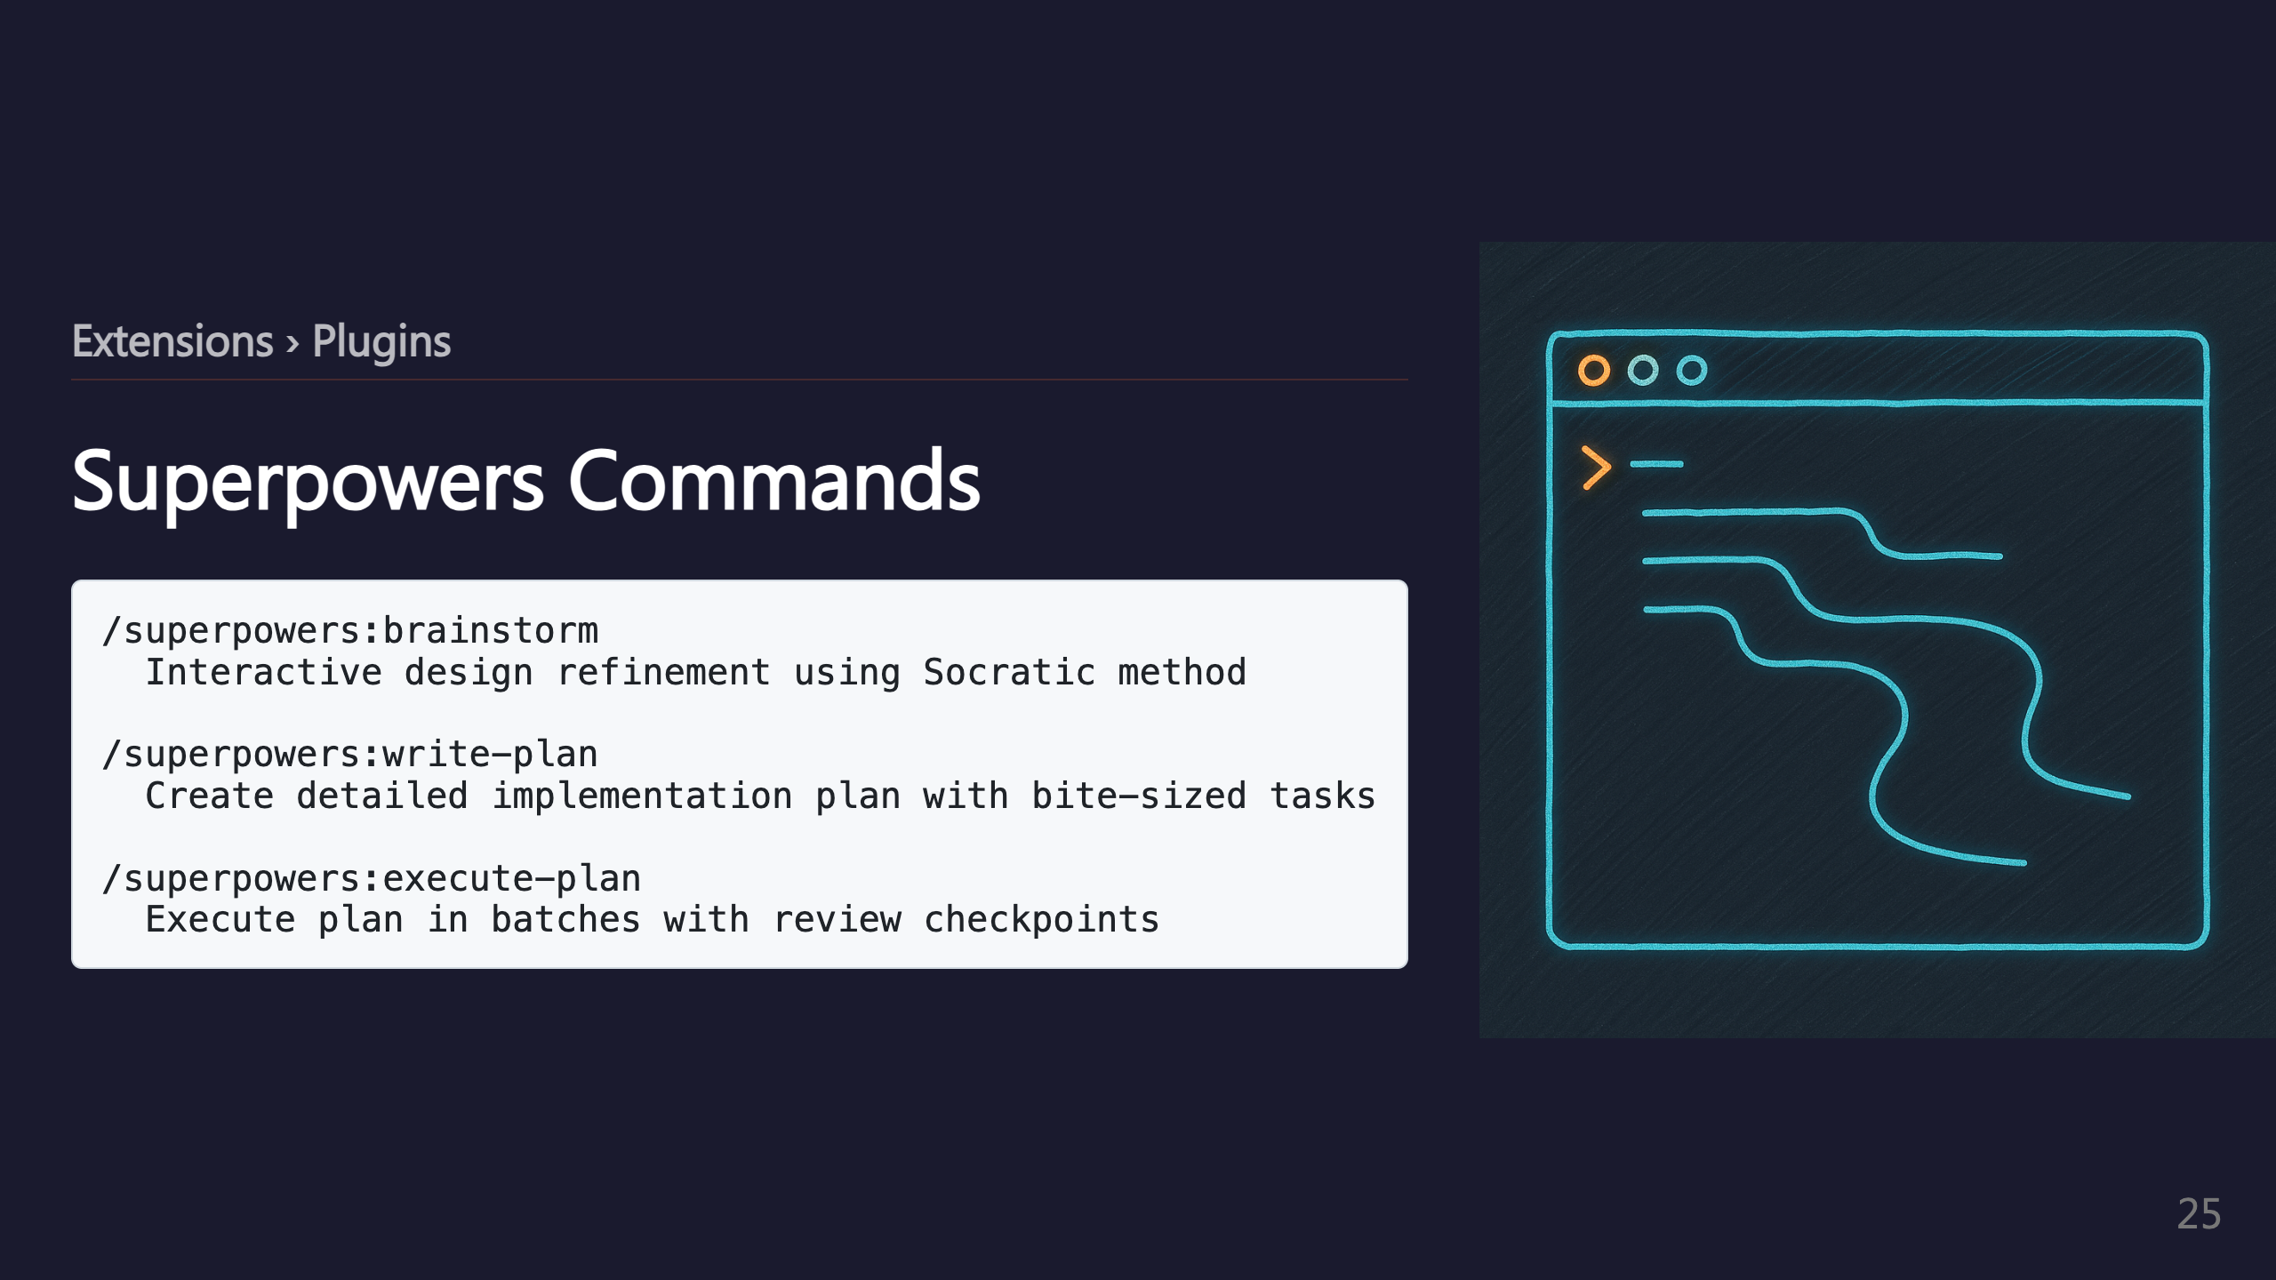

Slide 26
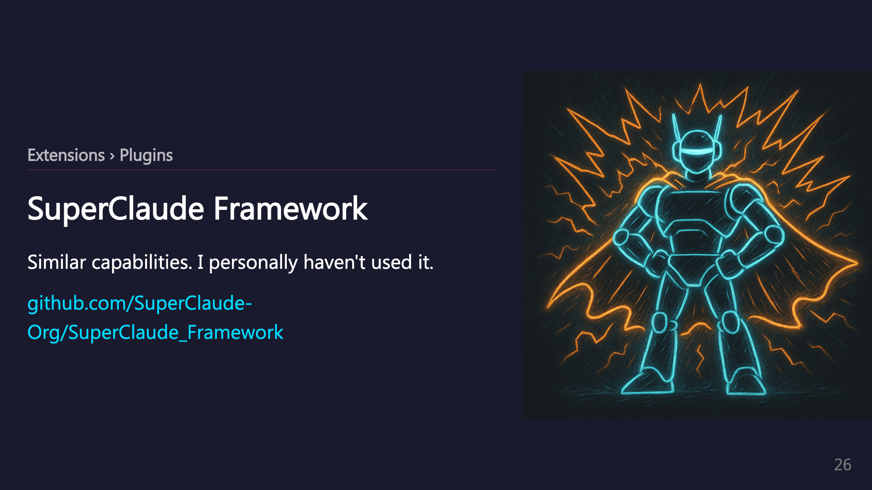
Notes:
_transition: push

Slide 27
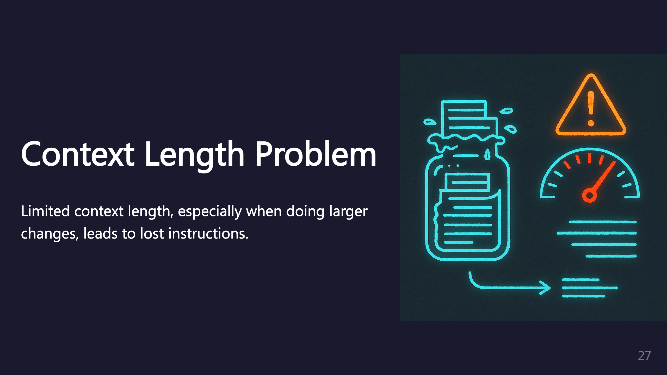
Notes:
SECTION: Context Length

Slide 28
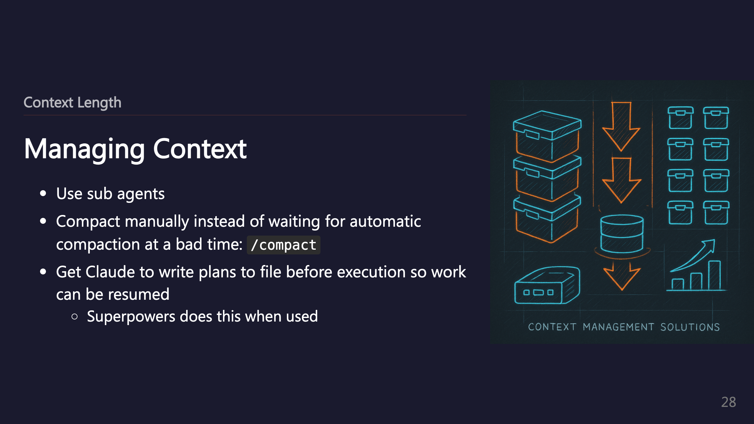

Slide 29
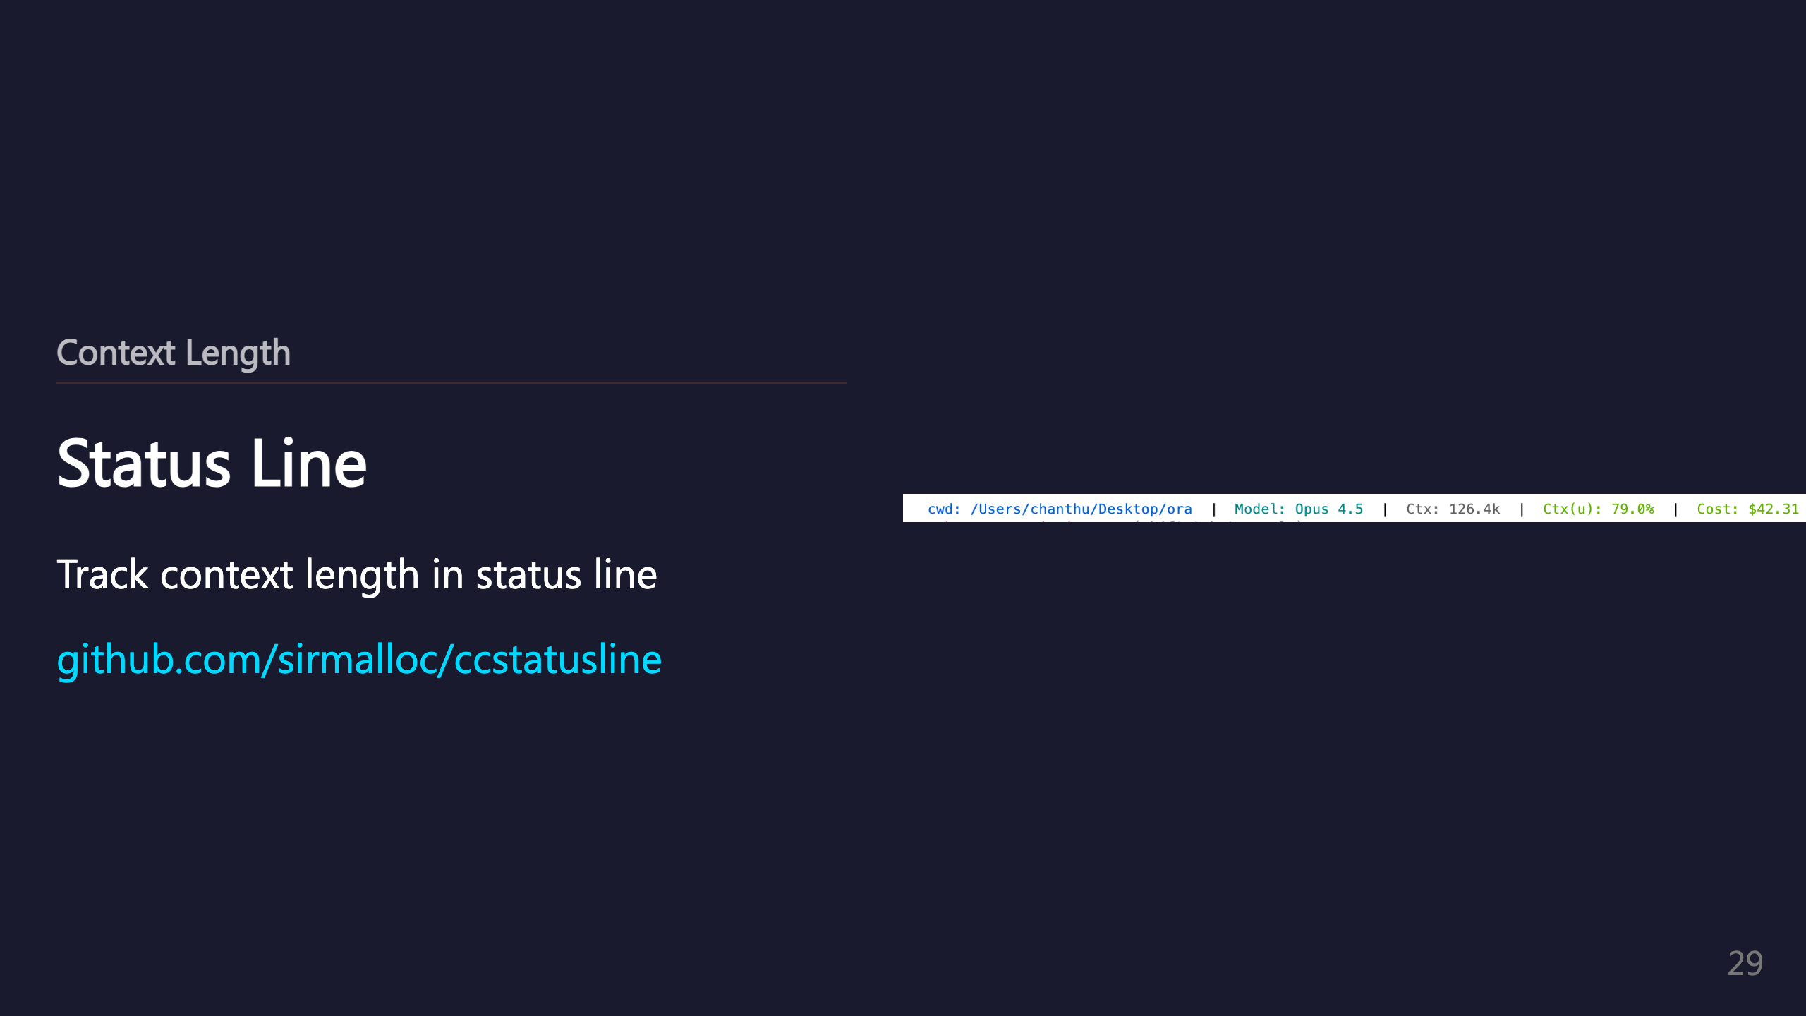
Notes:
_transition: push

Slide 30

Notes:
SECTION: Small Feature (umbrella)

Slide 31
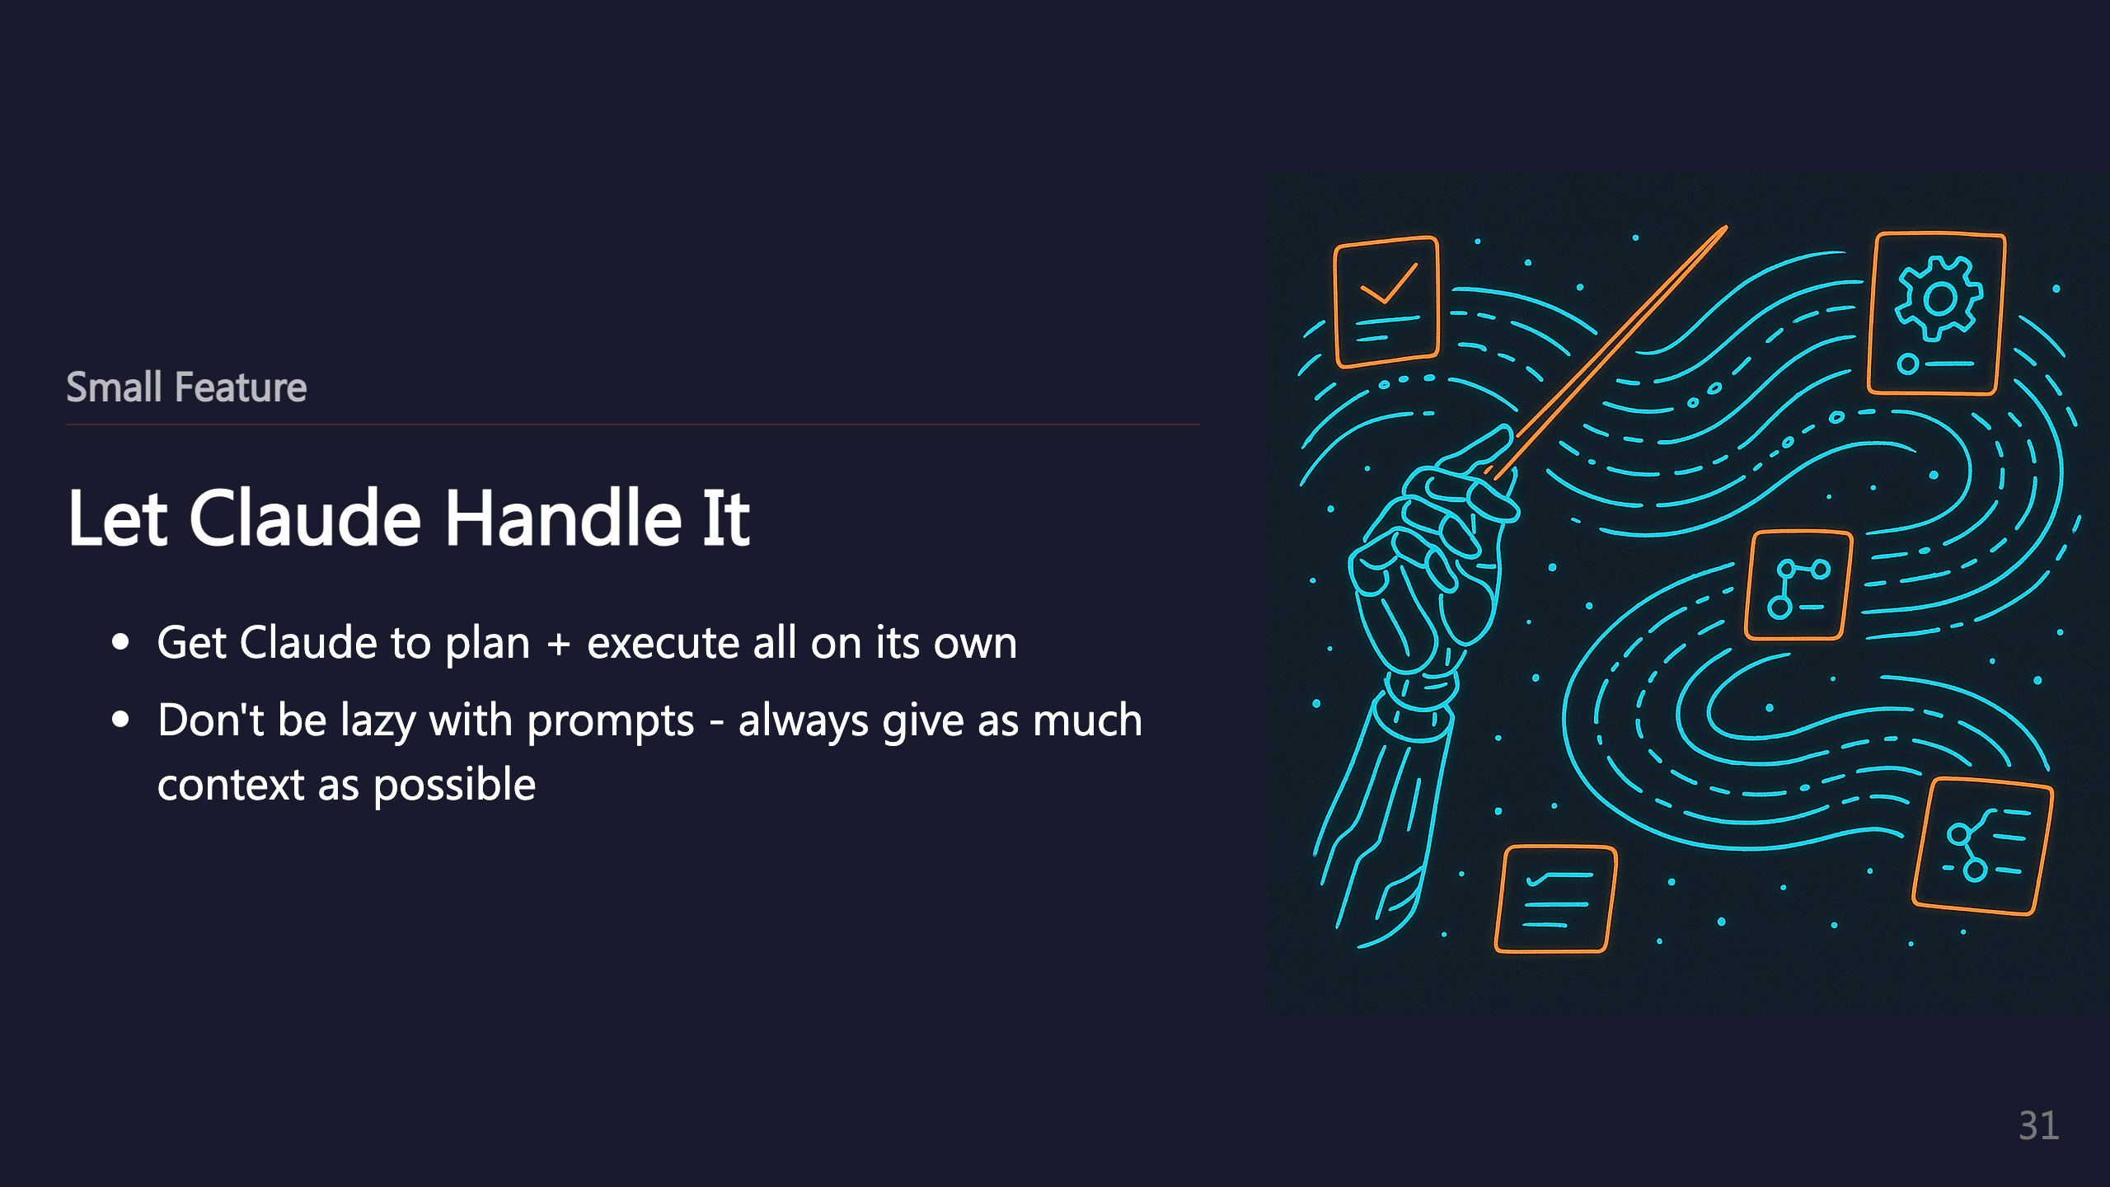

Slide 32
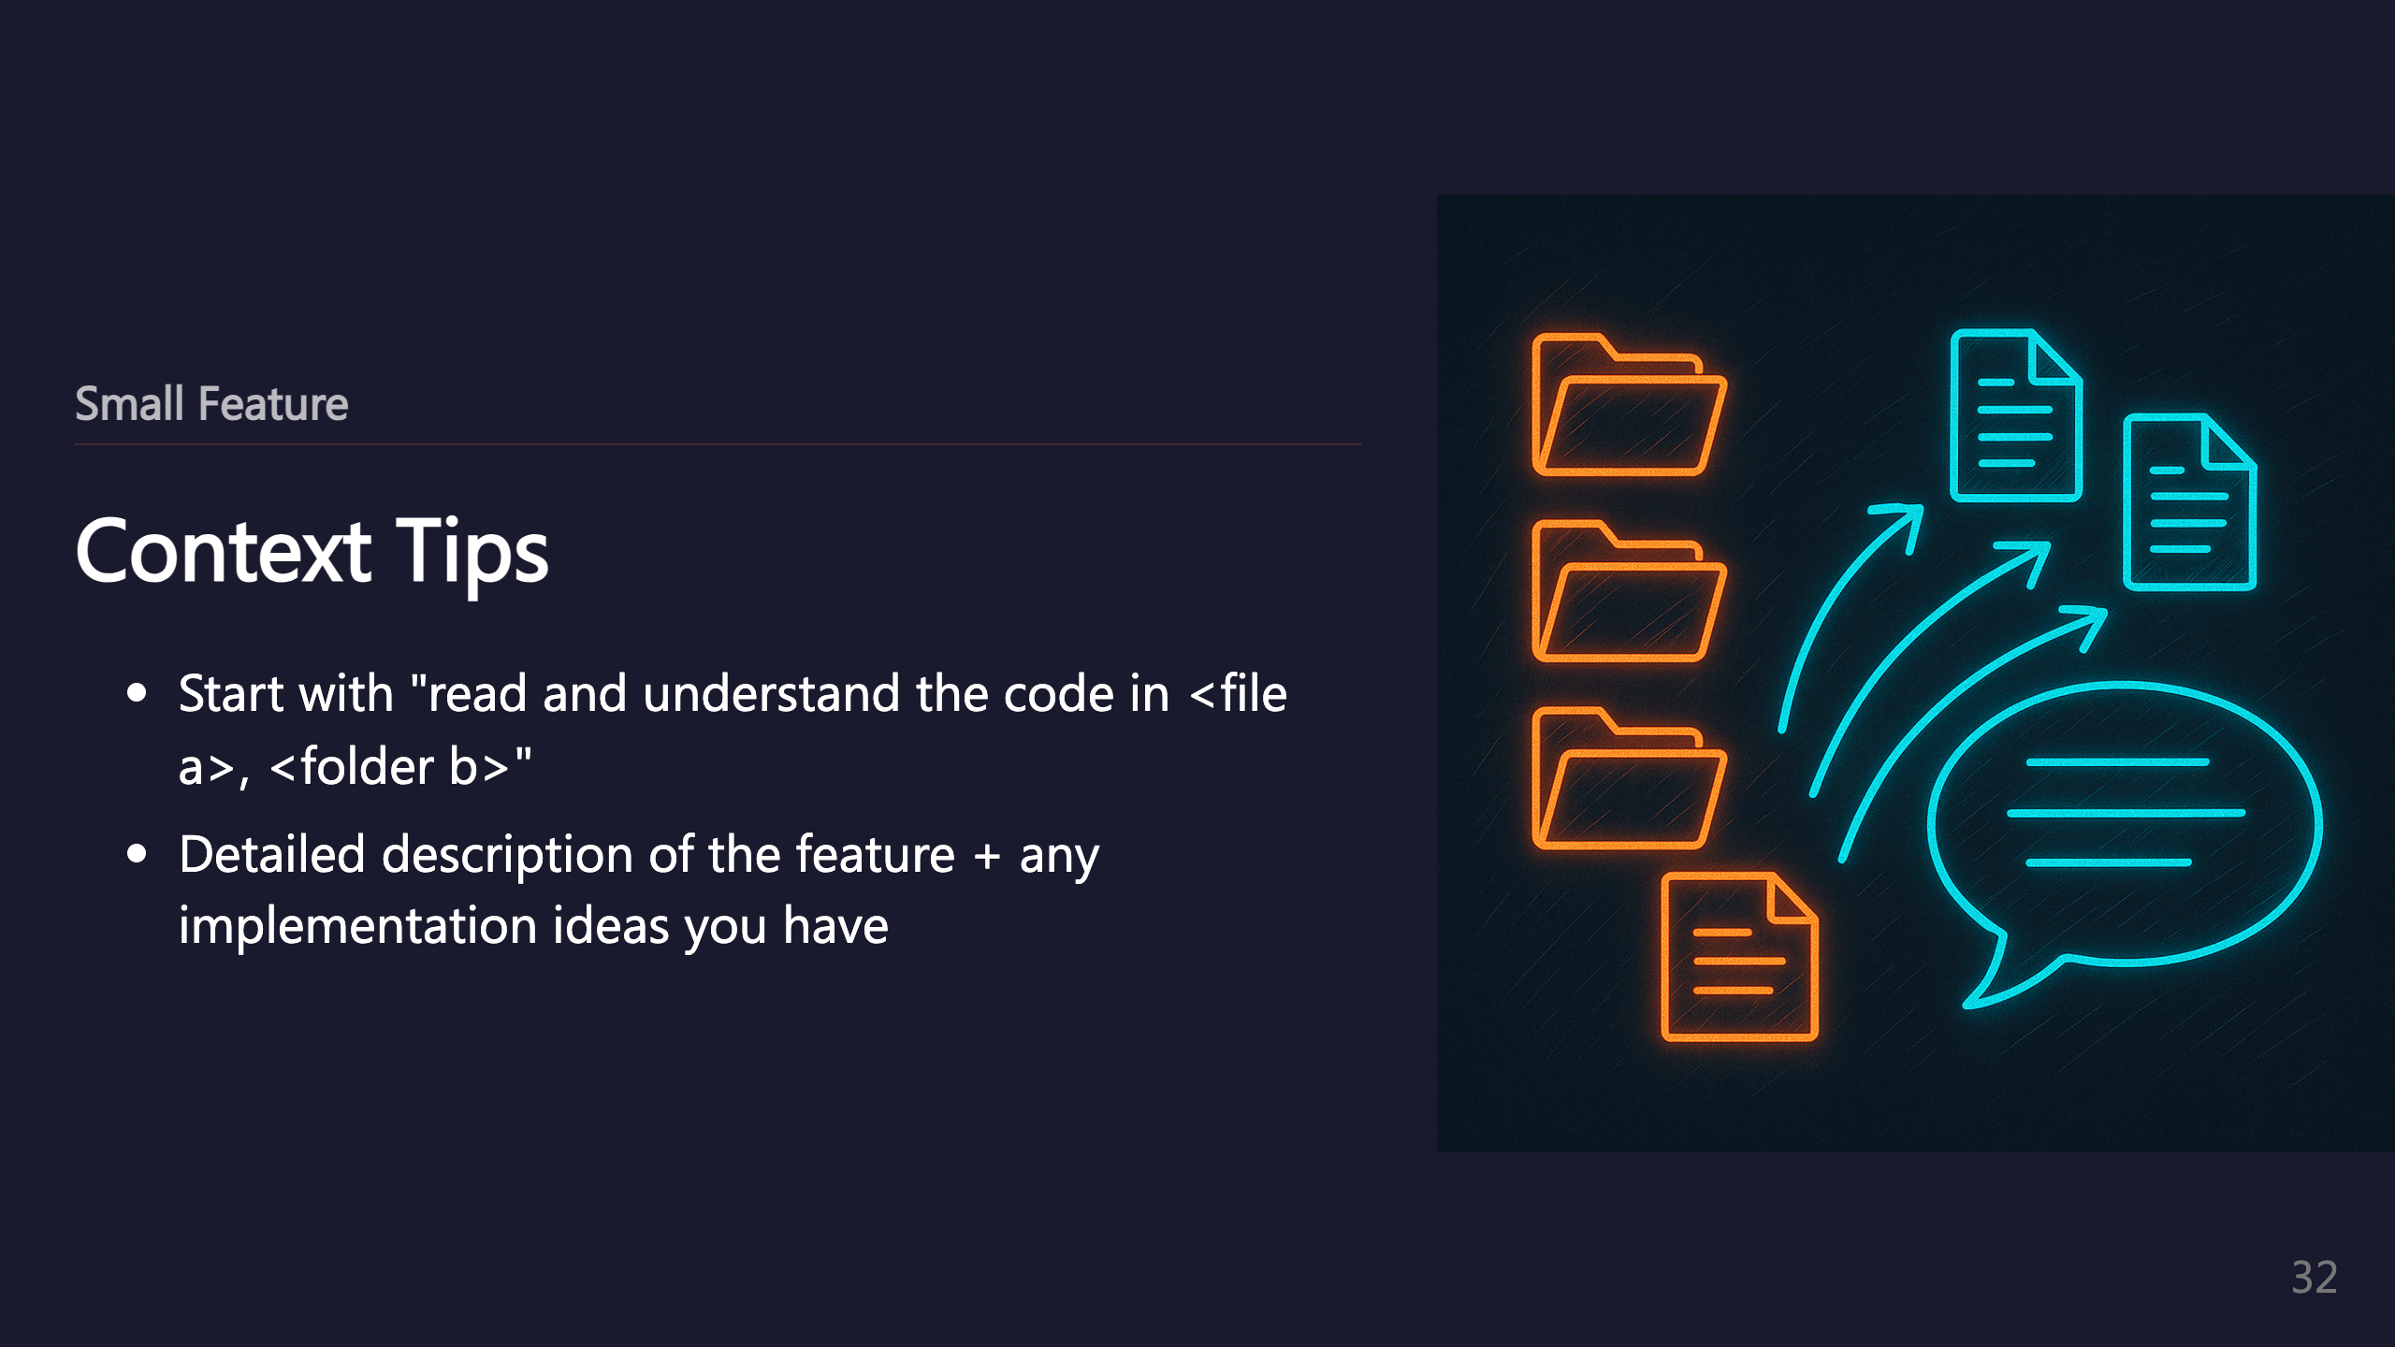

Slide 33
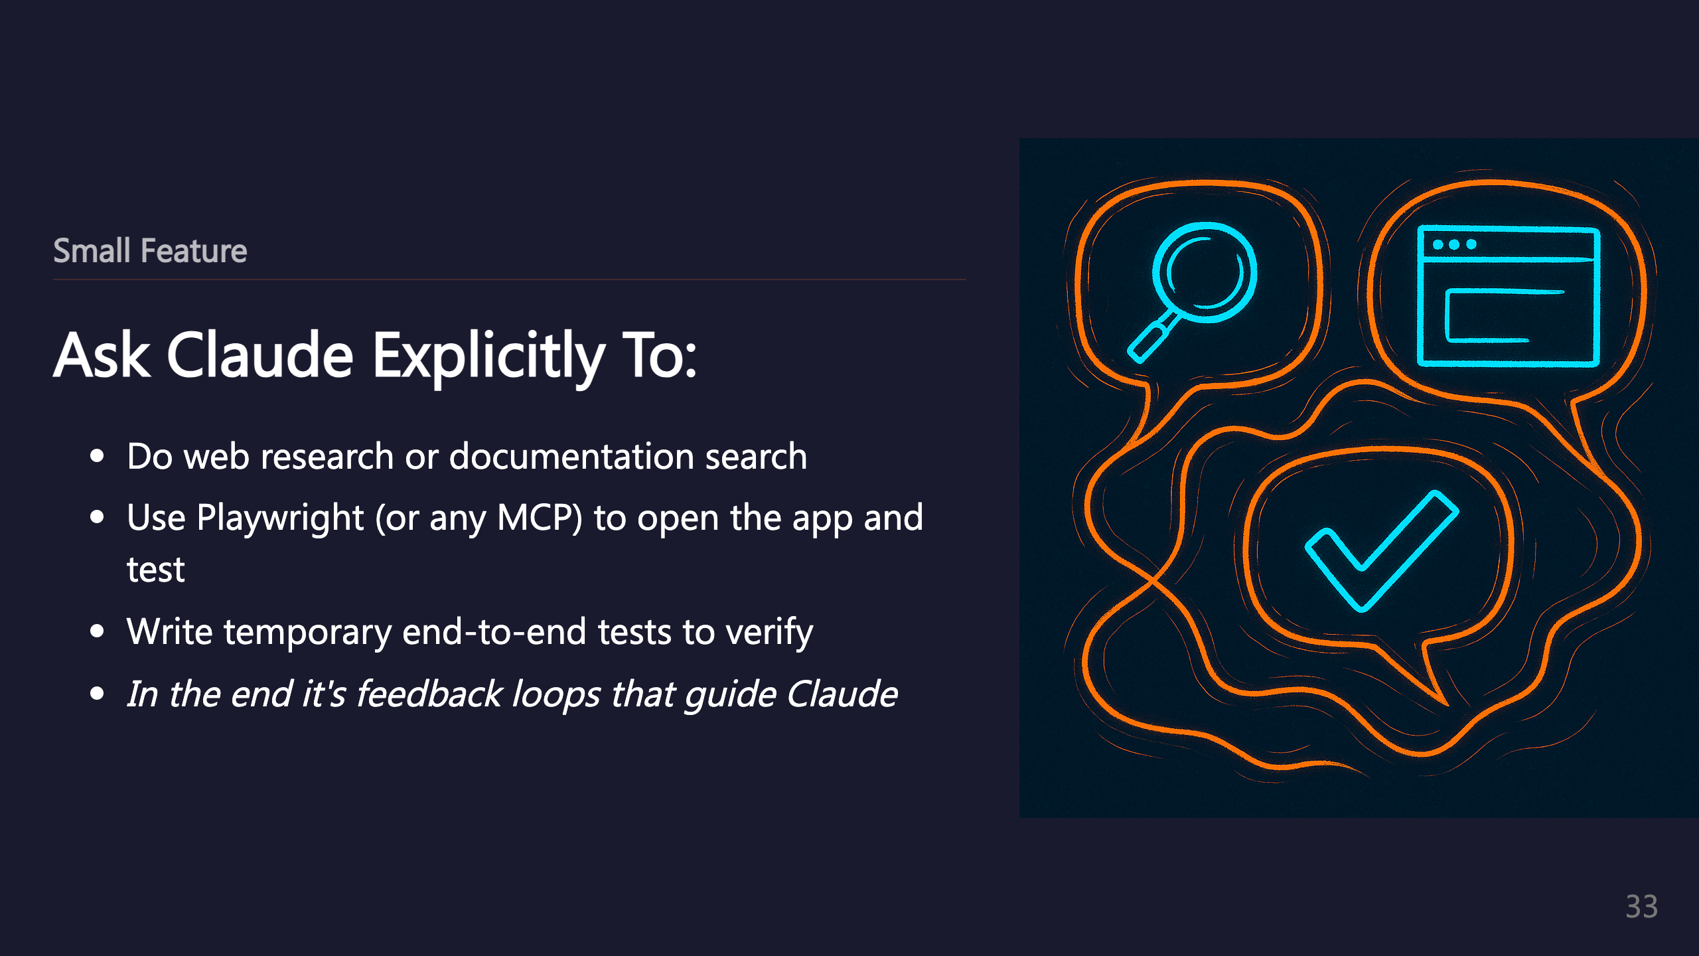
Notes:
_transition: push

Slide 34

Notes:
SECTION: Big Feature (umbrella)

Slide 35
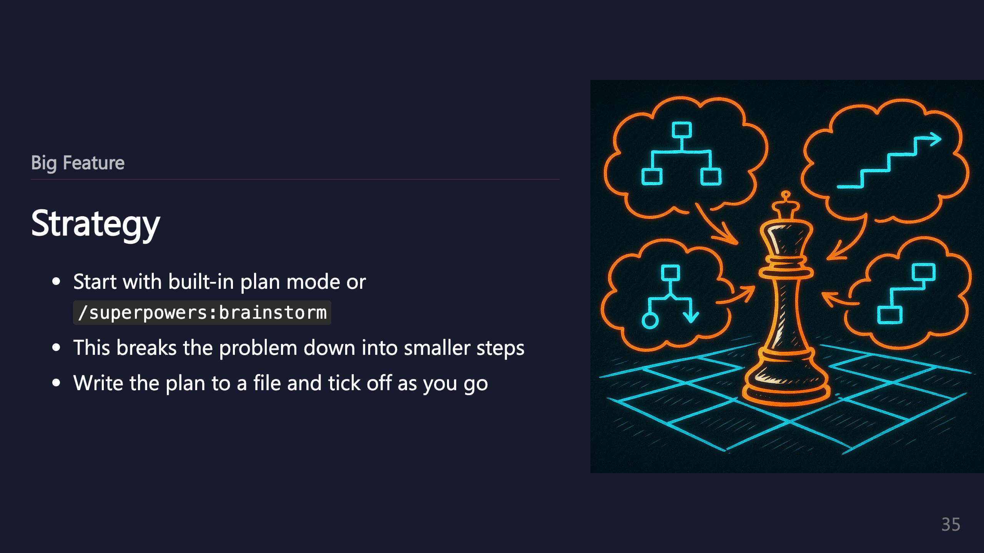

Slide 36
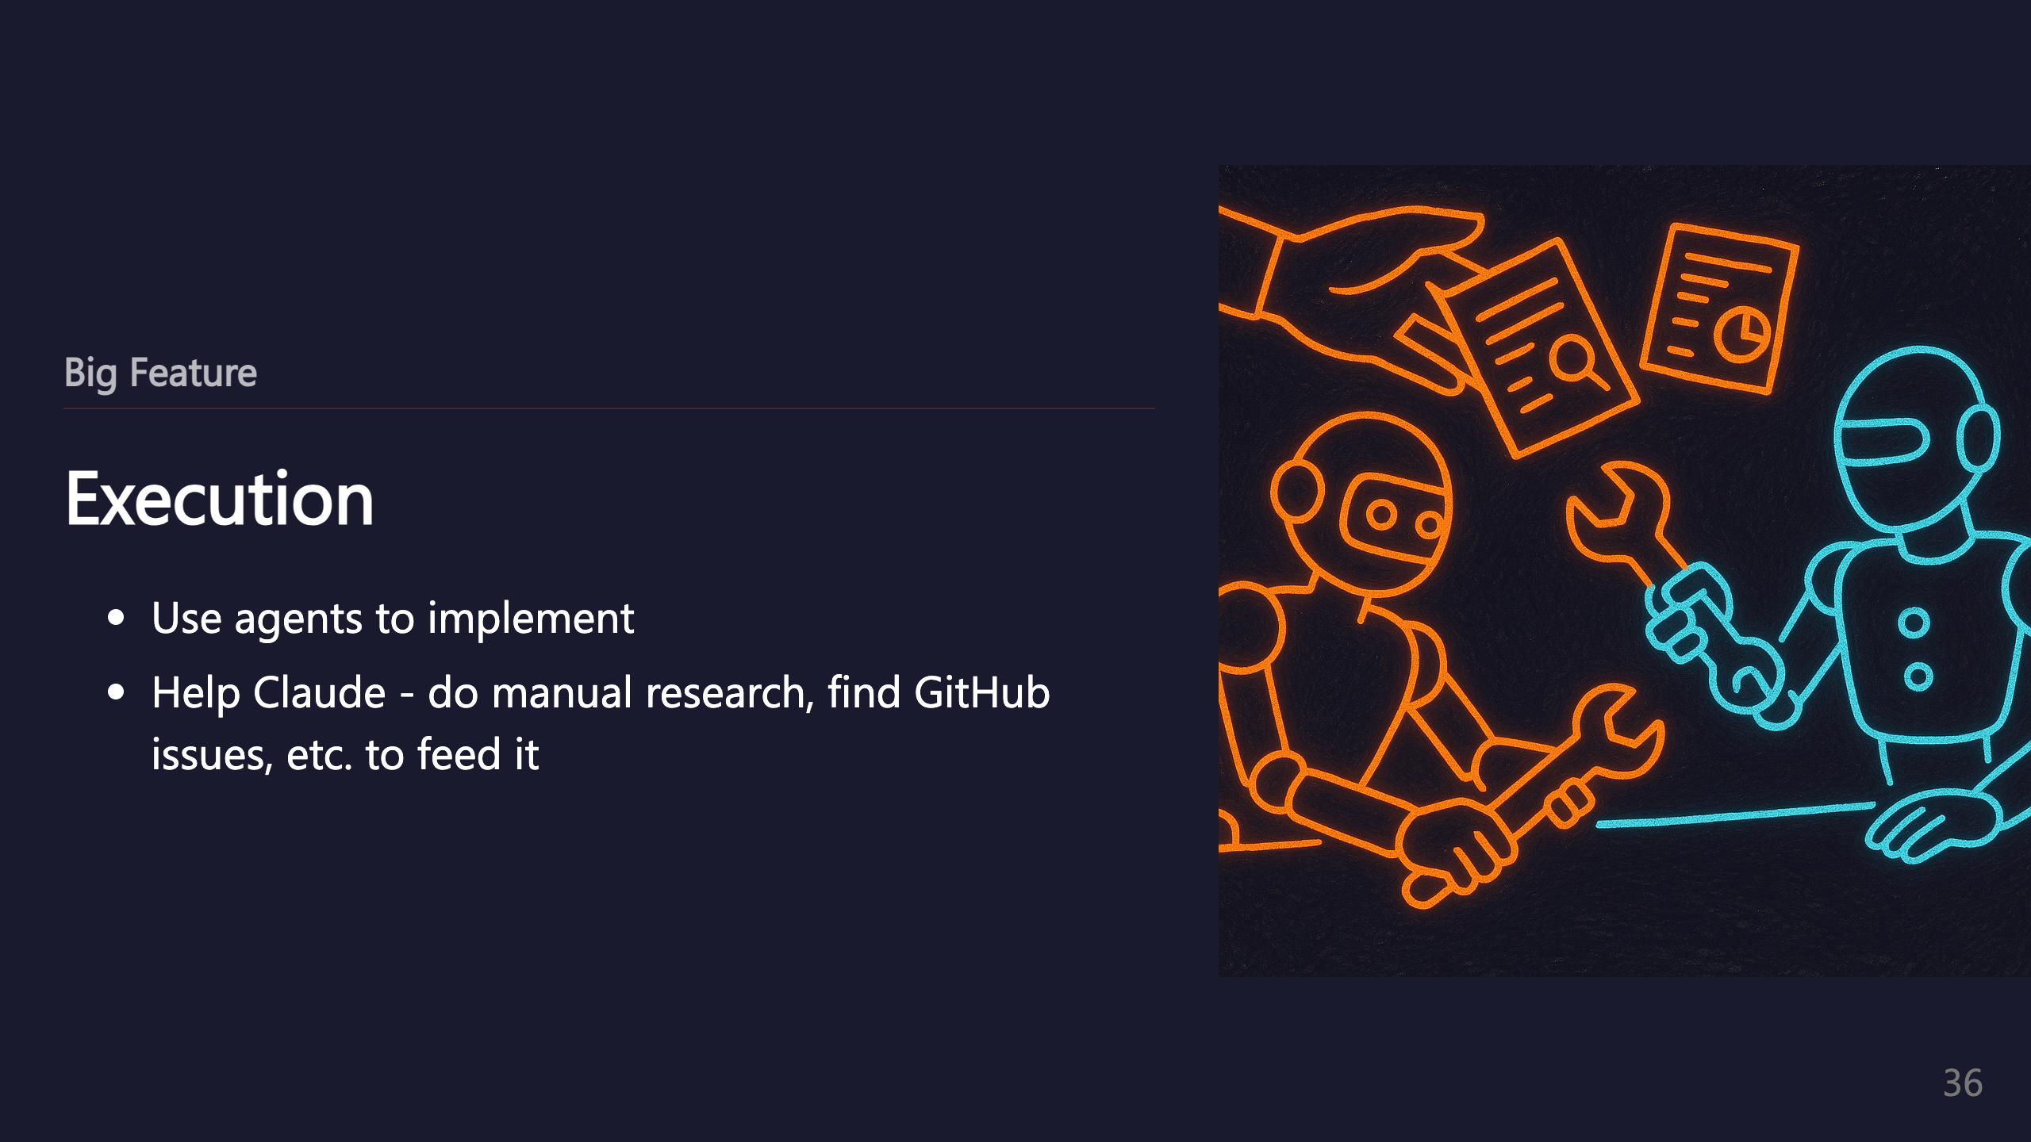

Slide 37
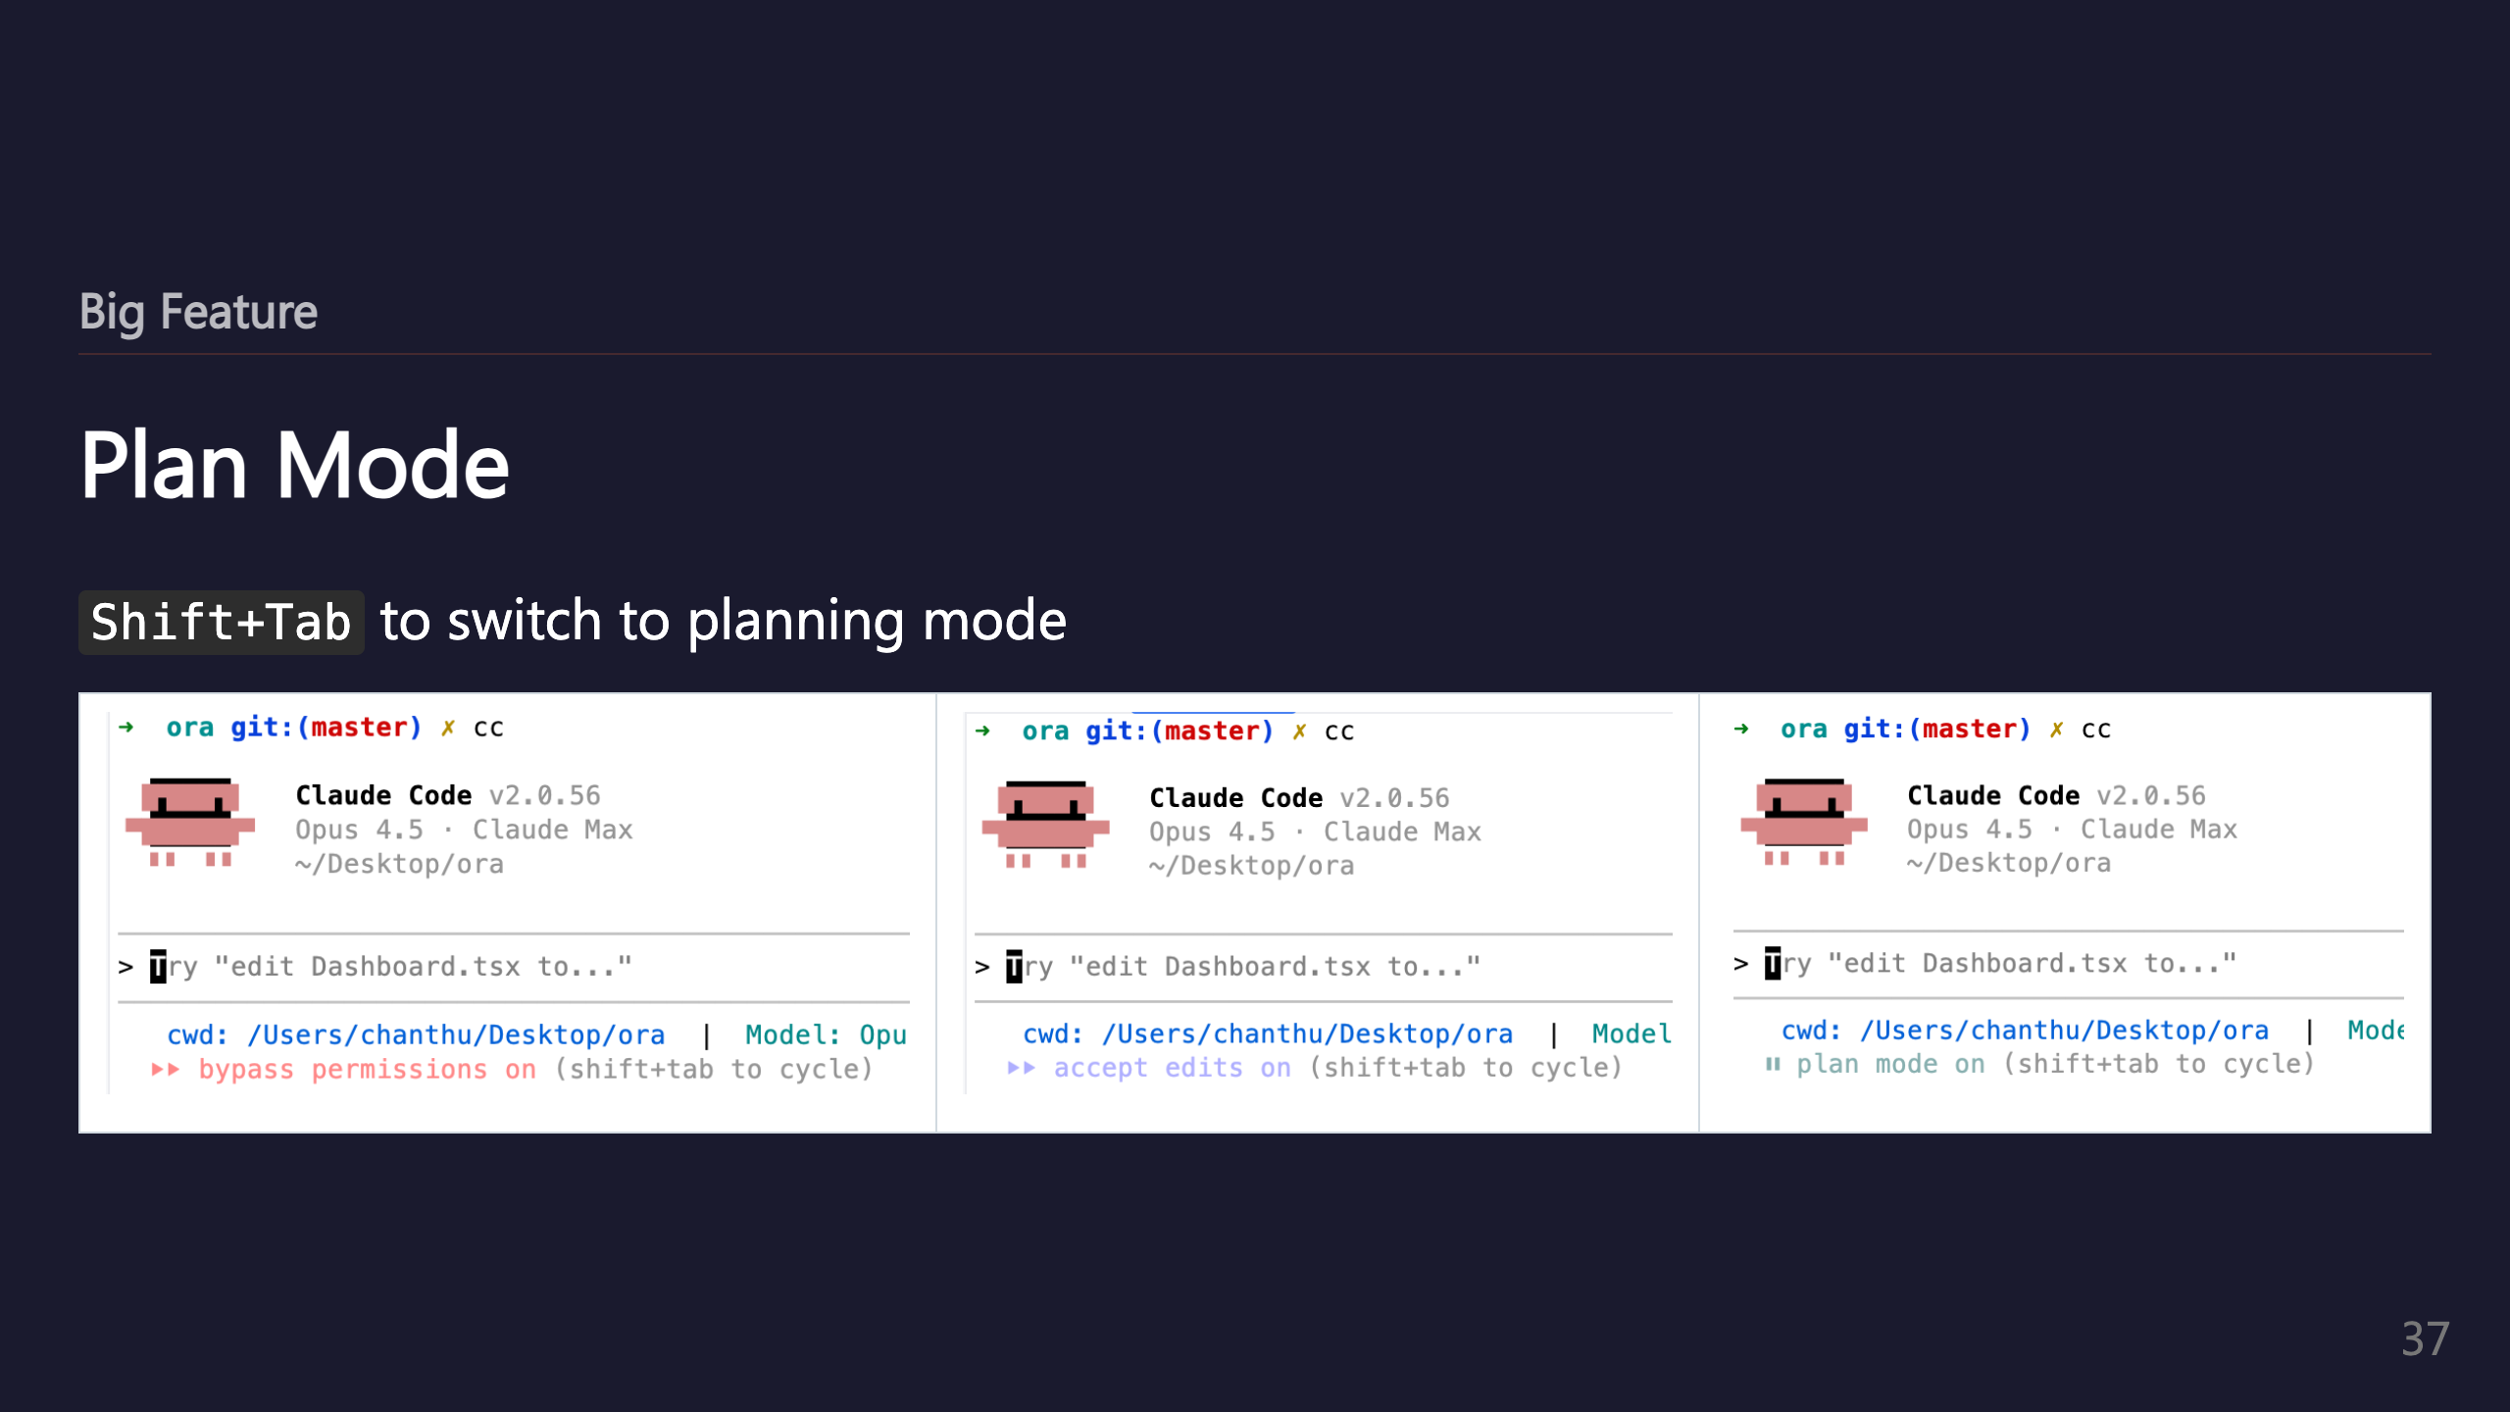
Notes:
_transition: push

Slide 38

Notes:
SECTION: Getting Unstuck

Slide 39
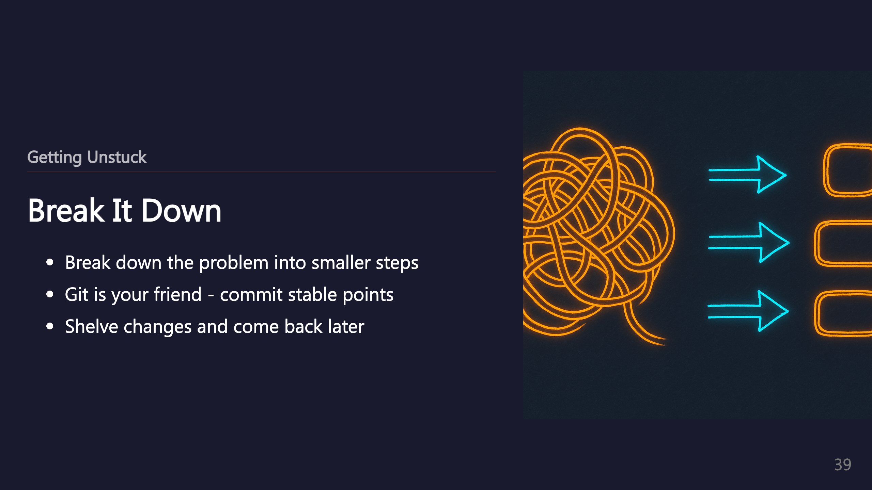

Slide 40
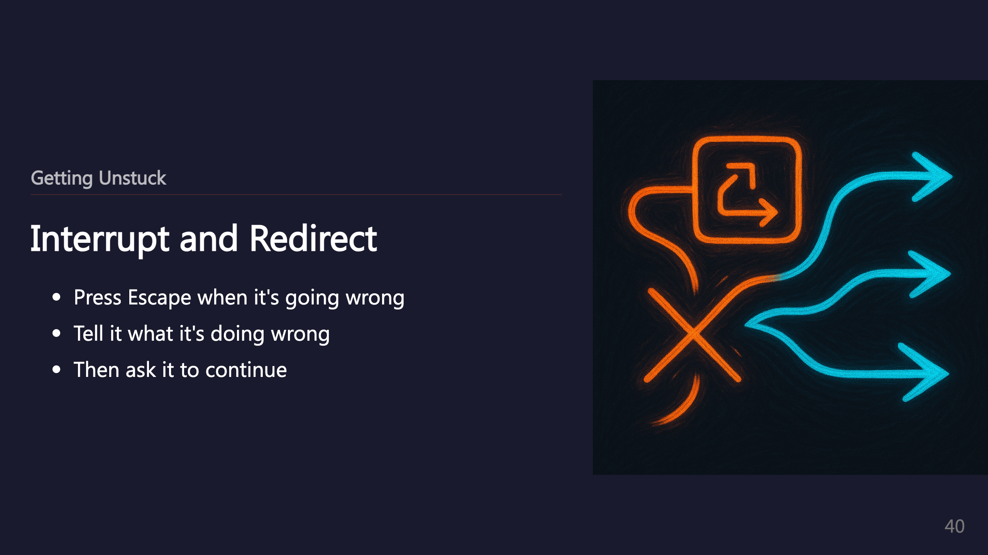

Slide 41
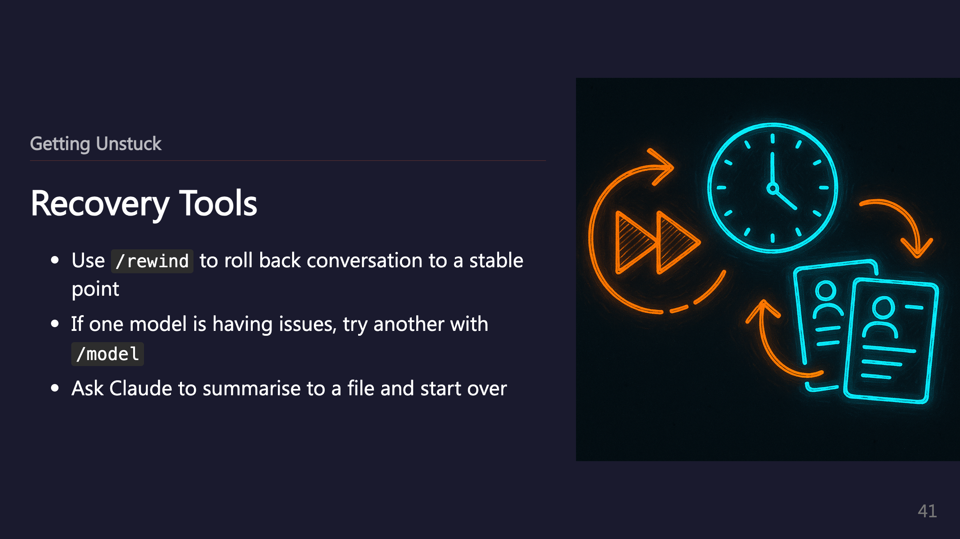
Notes:
_transition: push

Slide 42

Notes:
SECTION: Tips and Tricks

Slide 43
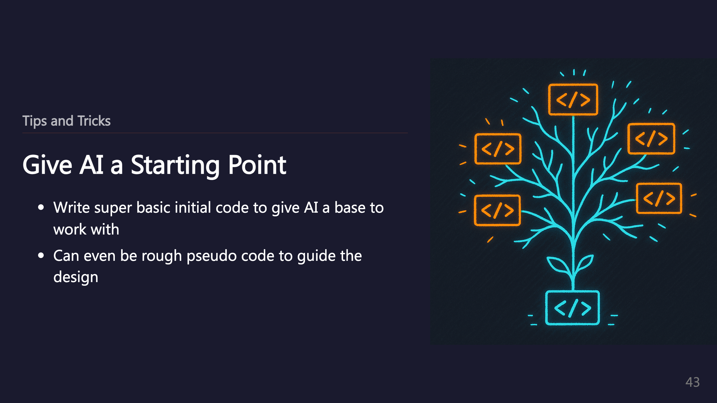

Slide 44
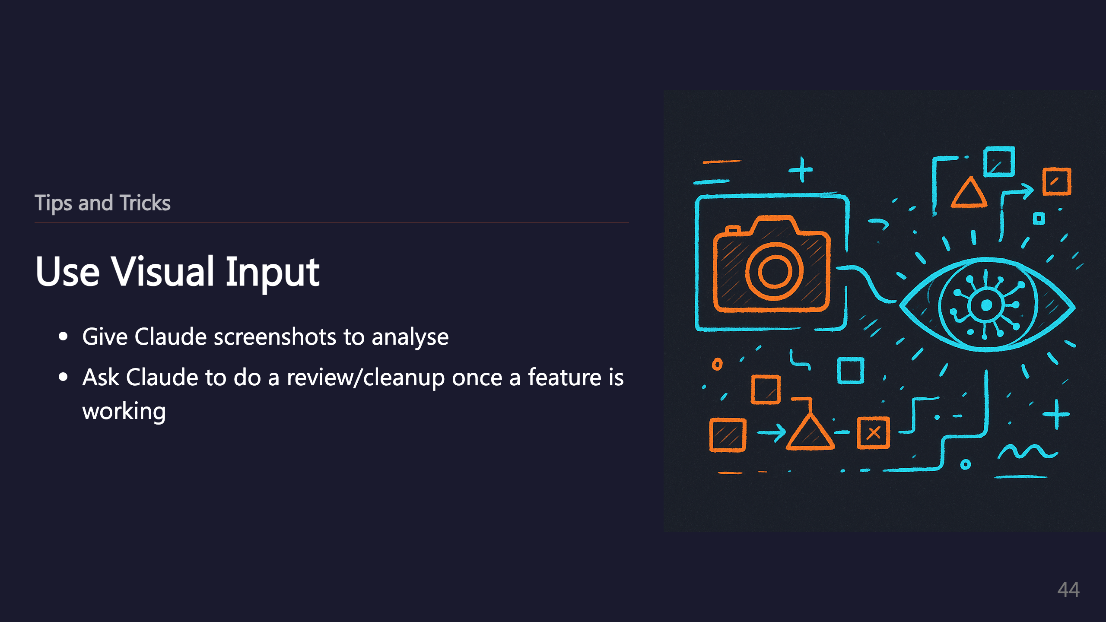

Slide 45
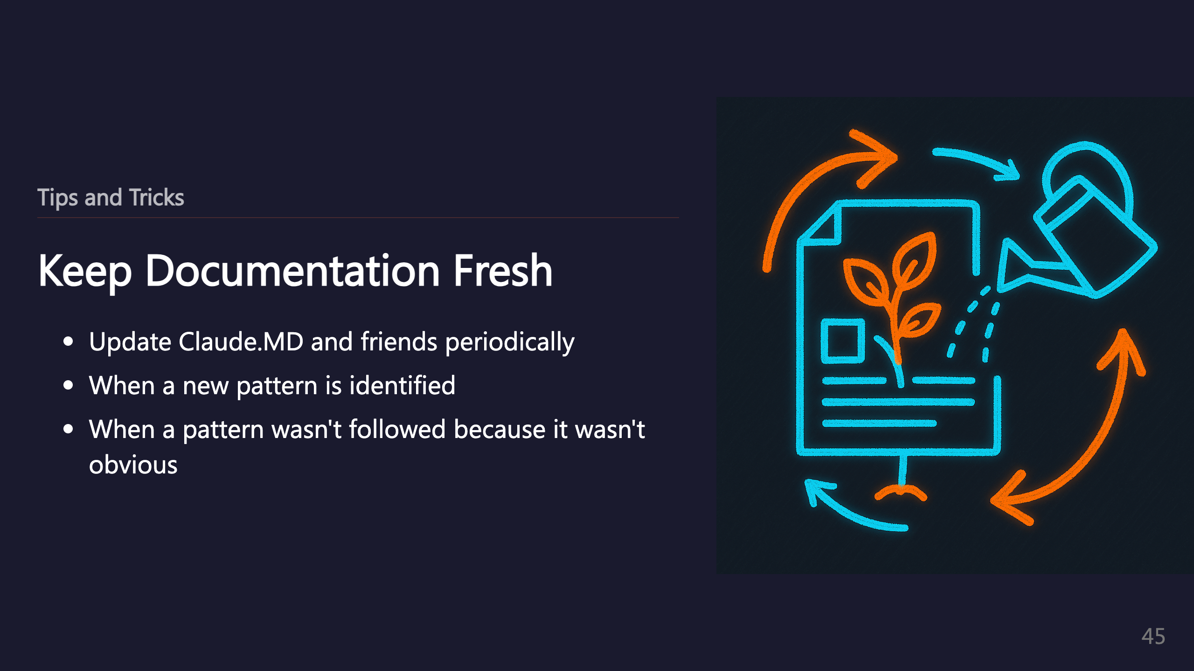

Slide 46
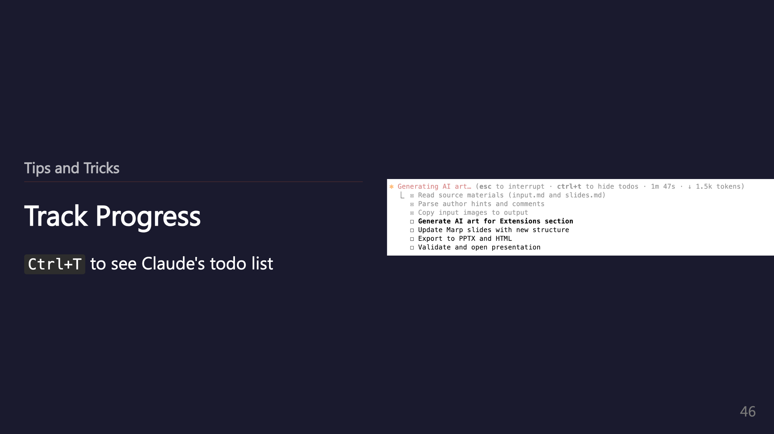
Notes:
_transition: push

Slide 47
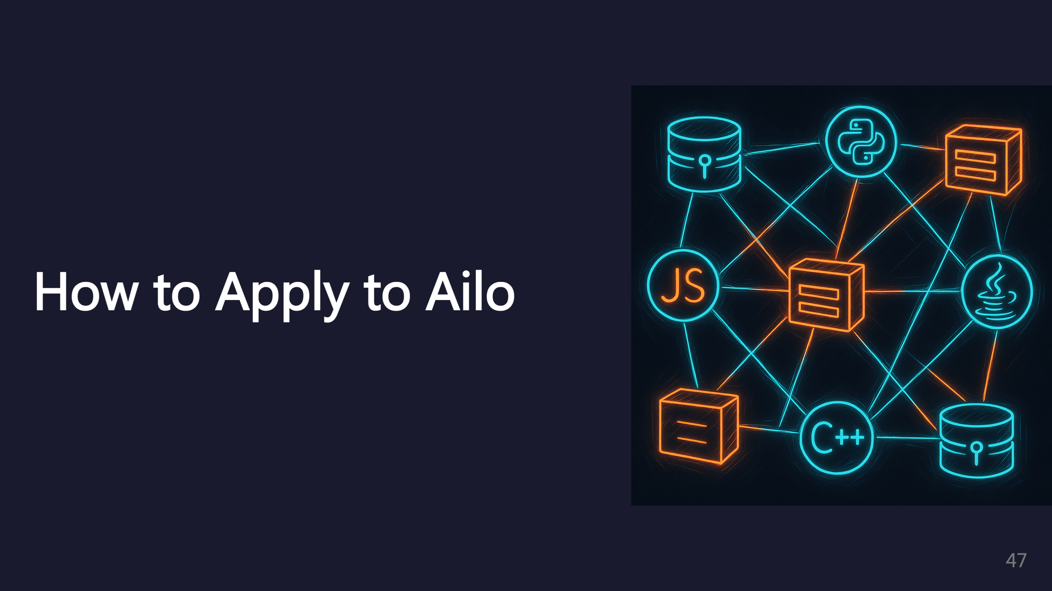
Notes:
SECTION: Ailo Repositories

Slide 48
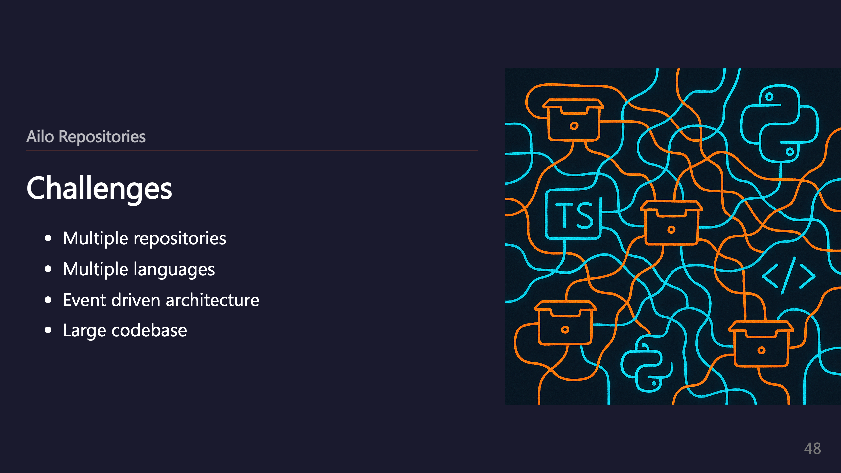

Slide 49
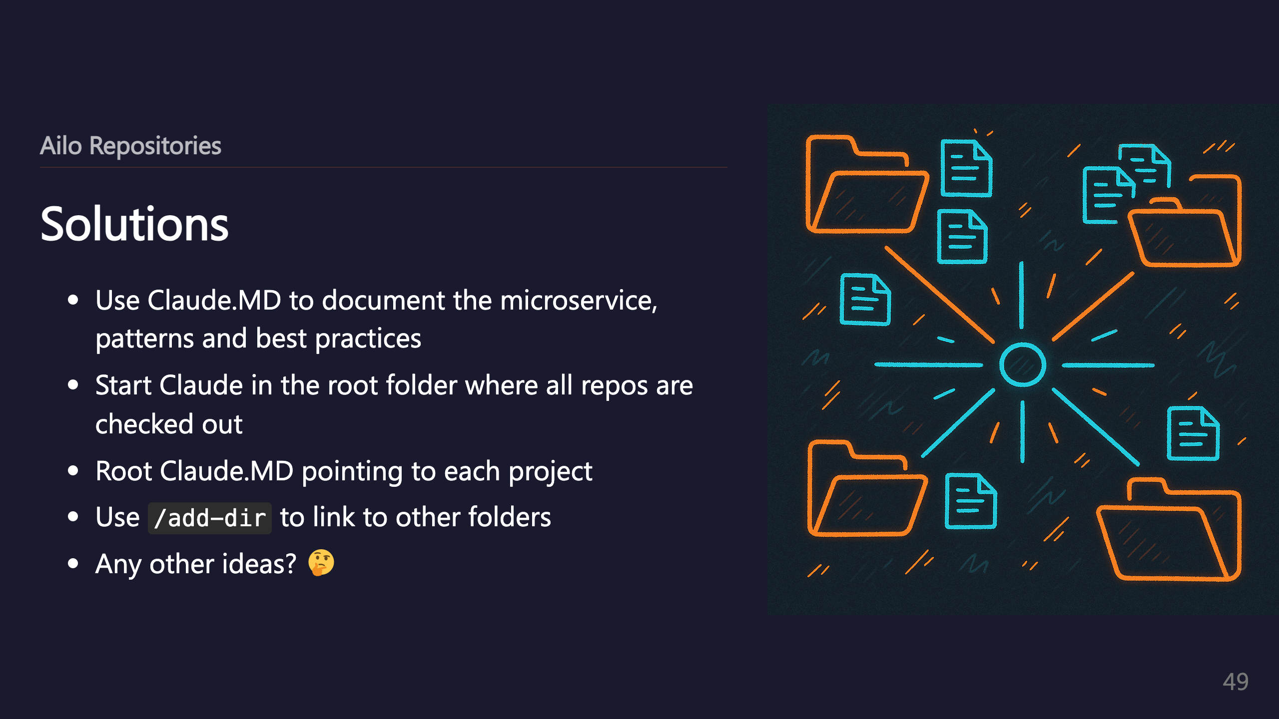
Notes:
_transition: push

Slide 50

Notes:
SECTION: Conclusion

Slide 51
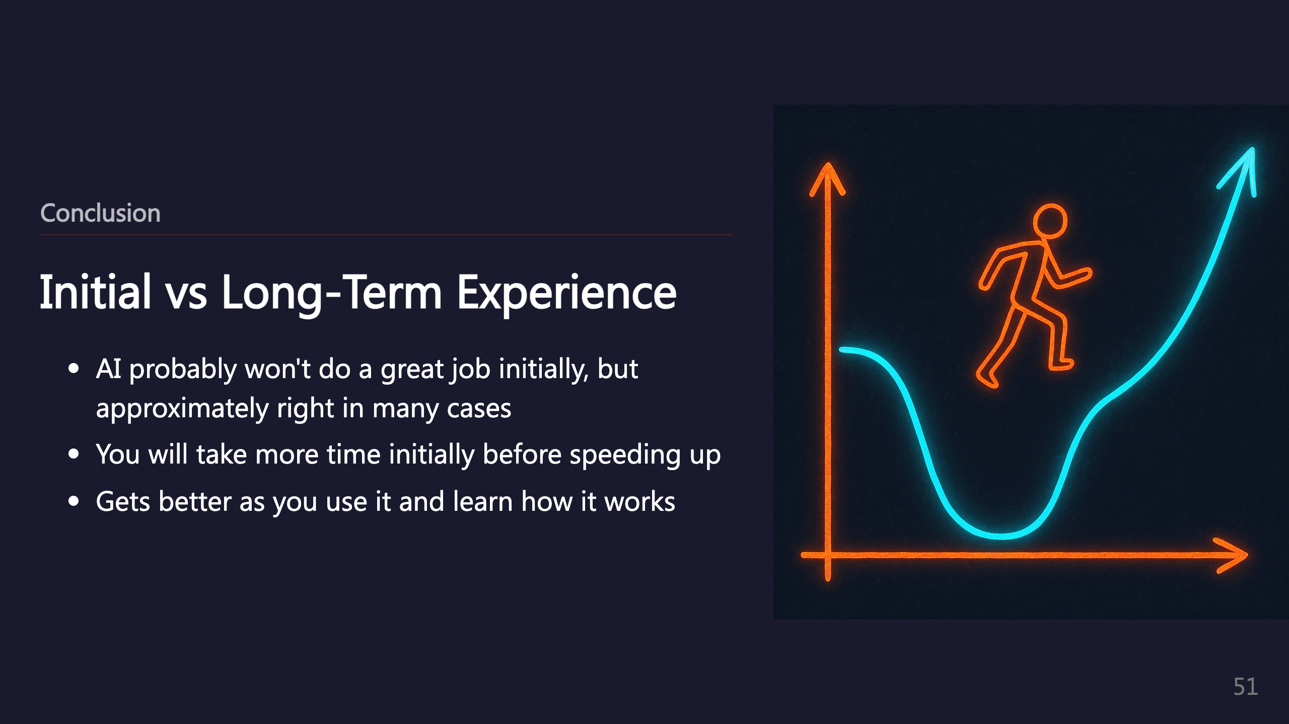

Slide 52


Slide 53
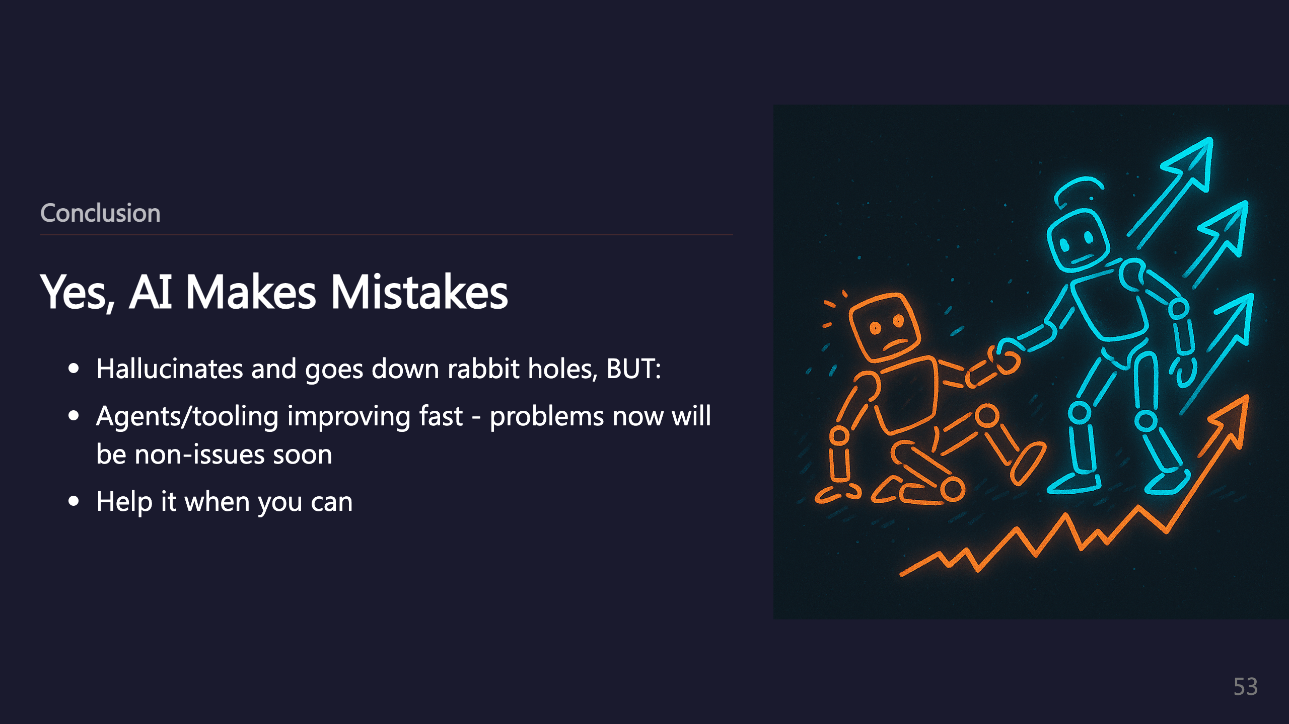

Slide 54
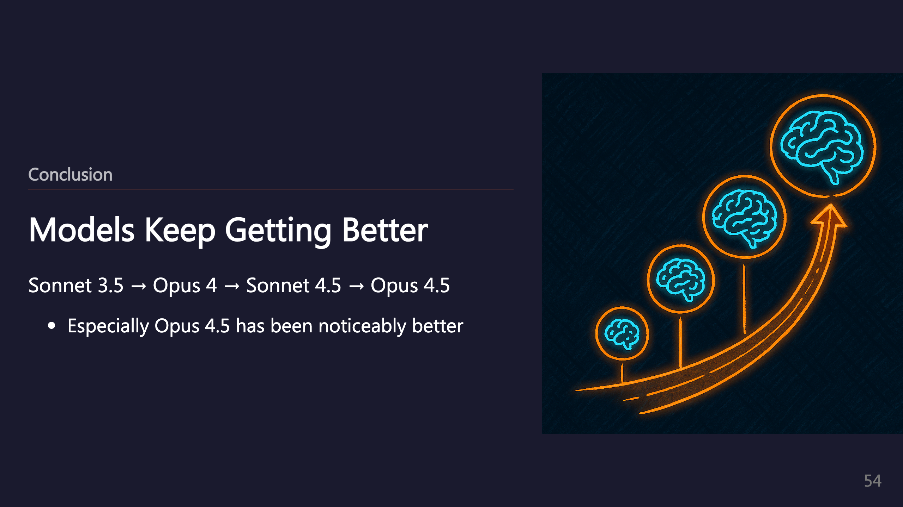
Notes:
Example: A refactor Sonnet 4.5 did unnecessarily split up a class into multiple ones, whereas Opus 4.5 identified that as a bad practice

